Slide 1
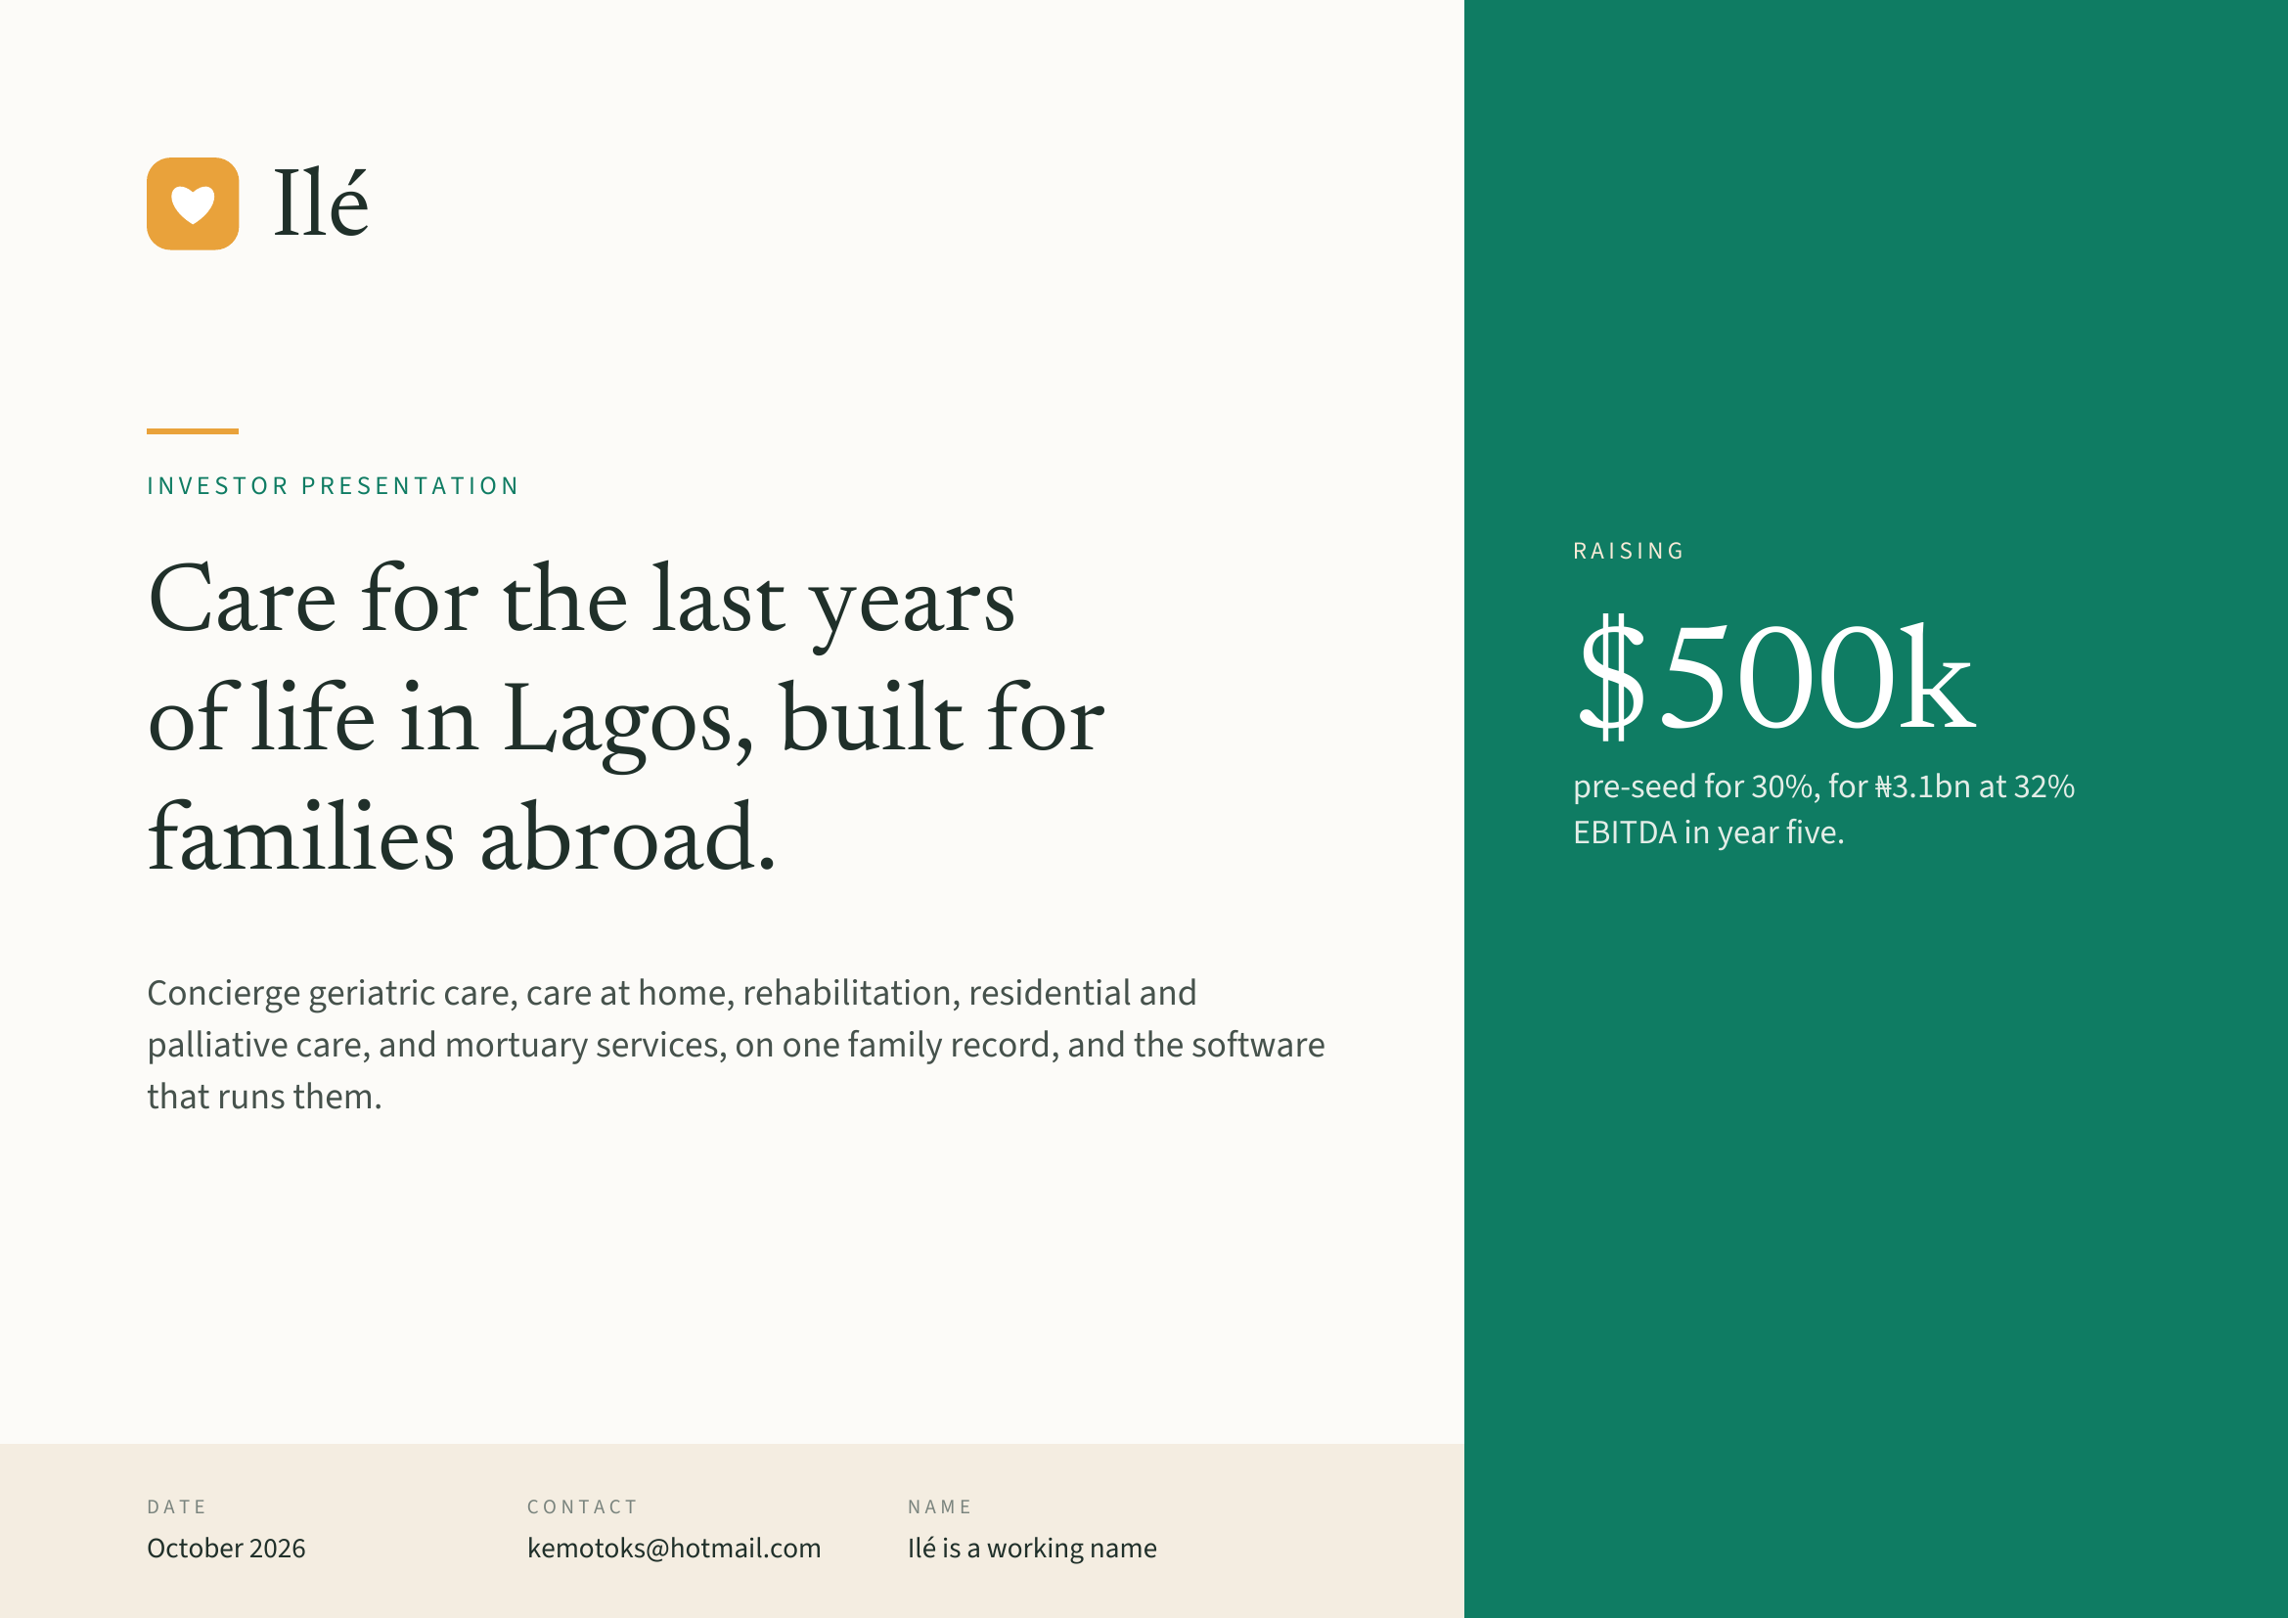
Notes:
Ilé
INVESTOR PRESENTATION
RAISING
Care for the last years
of life in Lagos, built for $500k
pre-seed for 30%, for ₦3.1bn at 32%
families abroad. EBITDA in year five.
Concierge geriatric care, care at home, rehabilitation, residential and
palliative care, and mortuary services, on one family record, and the software
that runs them.
DATE CONTACT NAME
October 2026 kemotoks@hotmail.com Ilé is a working name

Slide 2
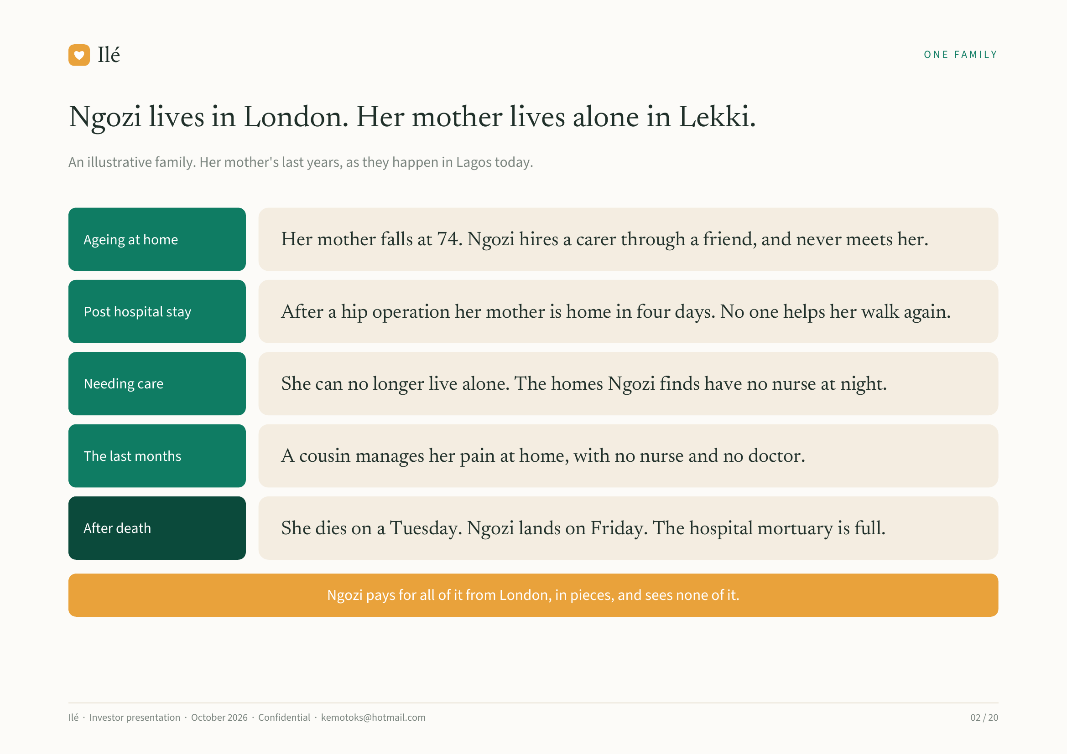
Notes:
Ilé ONE FAMILY
Ngozi lives in London. Her mother lives alone in Lekki.
An illustrative family. Her mother's last years, as they happen in Lagos today.
Ageing at home Her mother falls at 74. Ngozi hires a carer through a friend, and never meets her.
Post hospital stay After a hip operation her mother is home in four days. No one helps her walk again.
Needing care She can no longer live alone. The homes Ngozi finds have no nurse at night.
The last months A cousin manages her pain at home, with no nurse and no doctor.
After death She dies on a Tuesday. Ngozi lands on Friday. The hospital mortuary is full.
Ngozi pays for all of it from London, in pieces, and sees none of it.
Ilé · Investor presentation · October 2026 · Confidential · kemotoks@hotmail.com 02 / 20

Slide 3
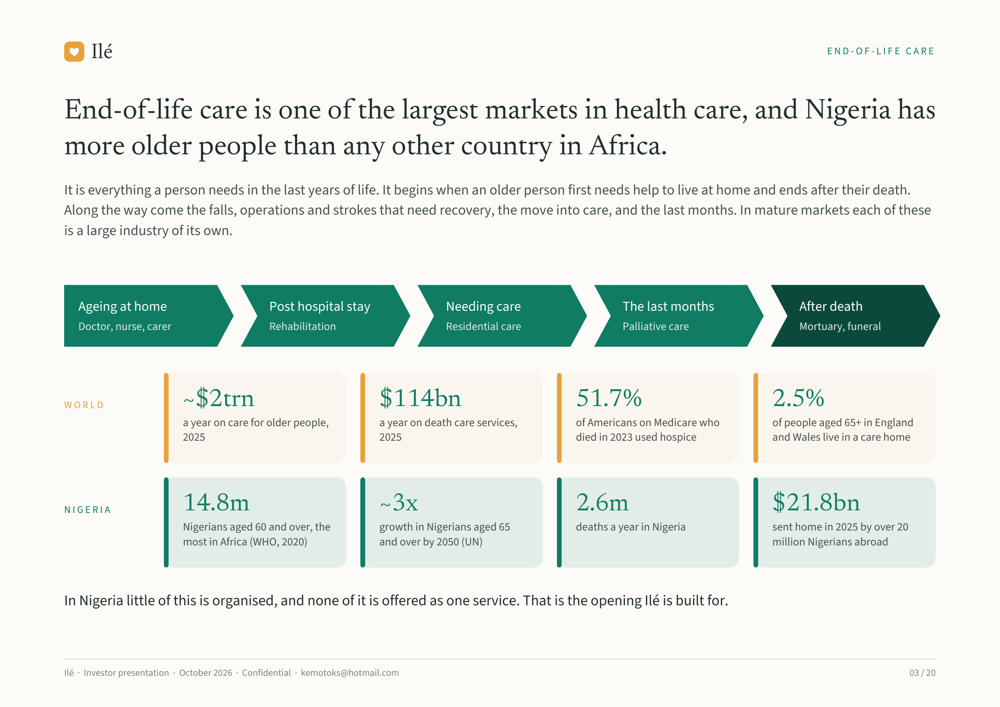
Notes:
Ilé END-OF-LIFE CARE
End-of-life care is one of the largest markets in health care, and Nigeria has
more older people than any other country in Africa.
It is everything a person needs in the last years of life. It begins when an older person first needs help to live at home and ends after their death.
Along the way come the falls, operations and strokes that need recovery, the move into care, and the last months. In mature markets each of these
is a large industry of its own.
Ageing at home Post hospital stay Needing care The last months After death
Doctor, nurse, carer Rehabilitation Residential care Palliative care Mortuary, funeral
WORLD ~$2trn $114bn 51.7% 2.5%
a year on care for older people, a year on death care services, of Americans on Medicare who of people aged 65+ in England
2025 2025 died in 2023 used hospice and Wales live in a care home
NIGERIA 14.8m ~3x 2.6m $21.8bn
Nigerians aged 60 and over, the growth in Nigerians aged 65 deaths a year in Nigeria sent home in 2025 by over 20
most in Africa (WHO, 2020) and over by 2050 (UN) million Nigerians abroad
In Nigeria little of this is organised, and none of it is offered as one service. That is the opening Ilé is built for.
Ilé · Investor presentation · October 2026 · Confidential · kemotoks@hotmail.com 03 / 20

Slide 4
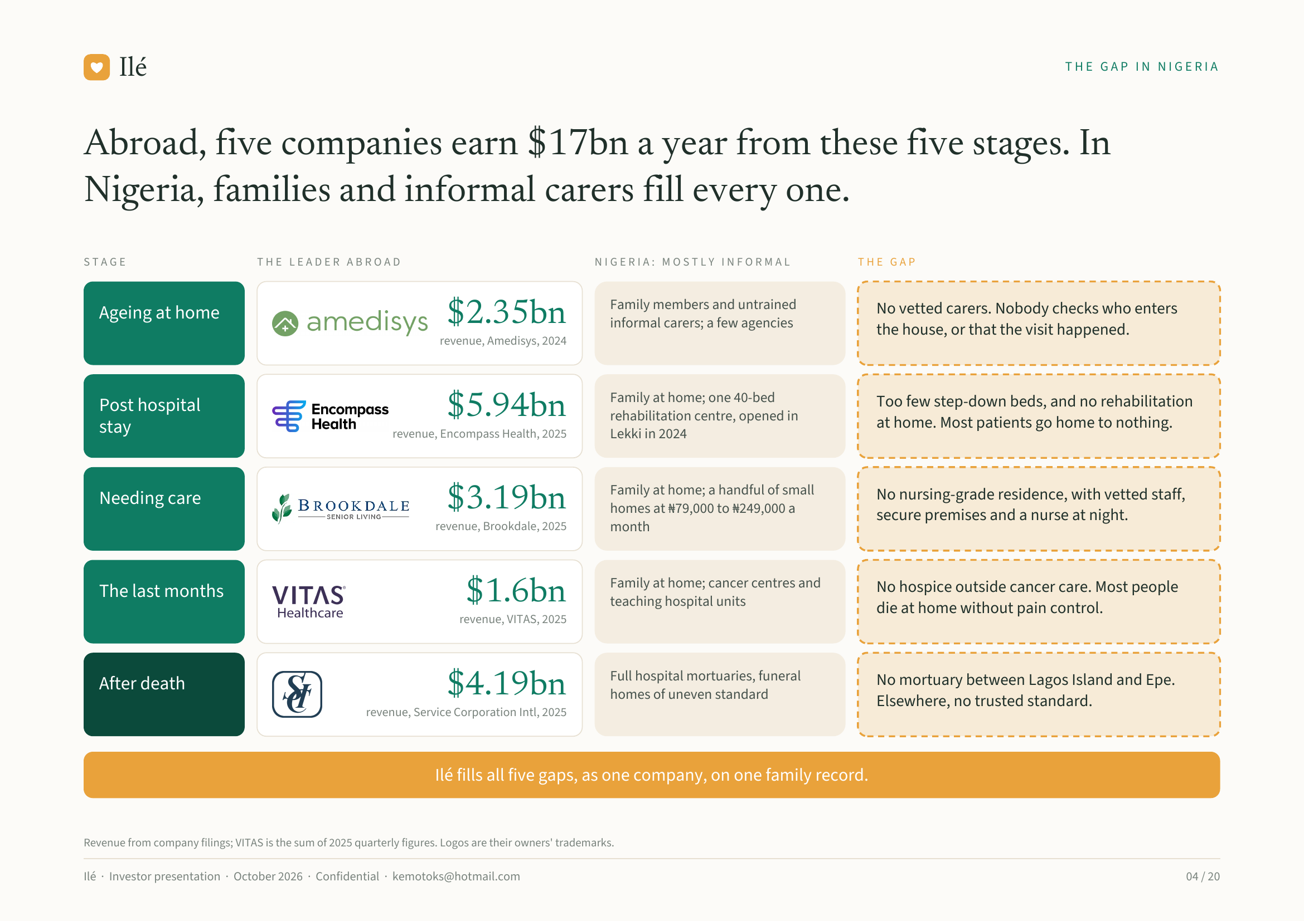
Notes:
Ilé THE GAP IN NIGERIA
Abroad, five companies earn $17bn a year from these five stages. In
Nigeria, families and informal carers fill every one.
STAGE THE LEADER ABROAD NIGERIA: MOSTLY INFORMAL THE GAP
Family members and untrained No vetted carers. Nobody checks who enters
Ageing at home $2.35bn informal carers; a few agencies
the house, or that the visit happened.
revenue, Amedisys, 2024
Family at home; one 40-bed Too few step-down beds, and no rehabilitation
Post hospital $5.94bn rehabilitation centre, opened in
at home. Most patients go home to nothing.
stay revenue, Encompass Health, 2025 Lekki in 2024
Family at home; a handful of small No nursing-grade residence, with vetted staff,
Needing care $3.19bn homes at ₦79,000 to ₦249,000 a
secure premises and a nurse at night.
revenue, Brookdale, 2025 month
Family at home; cancer centres and No hospice outside cancer care. Most people
The last months $1.6bn teaching hospital units
die at home without pain control.
revenue, VITAS, 2025
Full hospital mortuaries, funeral No mortuary between Lagos Island and Epe.
After death $4.19bn homes of uneven standard
Elsewhere, no trusted standard.
revenue, Service Corporation Intl, 2025
Ilé fills all five gaps, as one company, on one family record.
Revenue from company filings; VITAS is the sum of 2025 quarterly figures. Logos are their owners' trademarks.
Ilé · Investor presentation · October 2026 · Confidential · kemotoks@hotmail.com 04 / 20

Slide 5
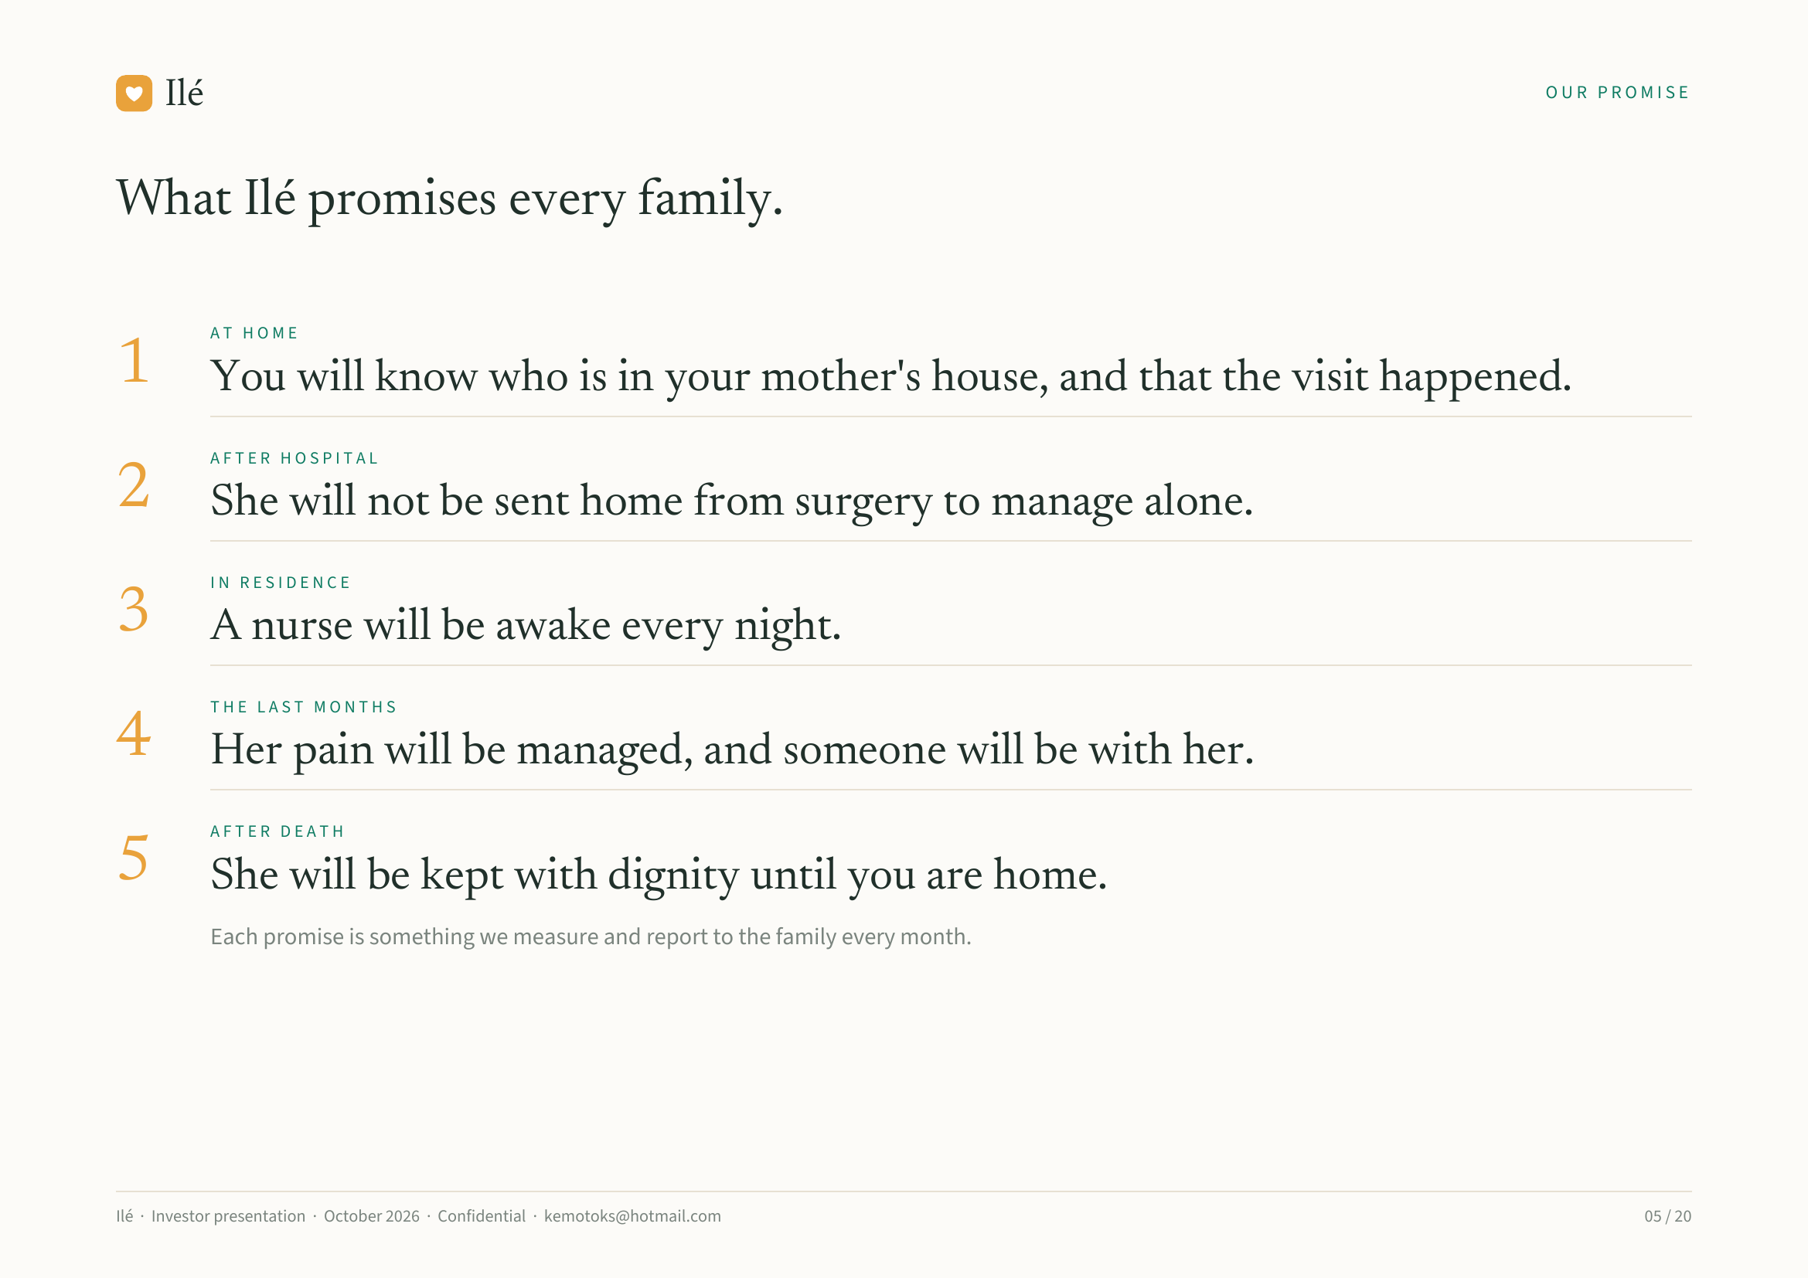
Notes:
Ilé OUR PROMISE
What Ilé promises every family.
AT HOME
1 You will know who is in your mother's house, and that the visit happened.
AFTER HOSPITAL
2 She will not be sent home from surgery to manage alone.
IN RESIDENCE
3 A nurse will be awake every night.
THE LAST MONTHS
4 Her pain will be managed, and someone will be with her.
AFTER DEATH
5 She will be kept with dignity until you are home.
Each promise is something we measure and report to the family every month.
Ilé · Investor presentation · October 2026 · Confidential · kemotoks@hotmail.com 05 / 20

Slide 6
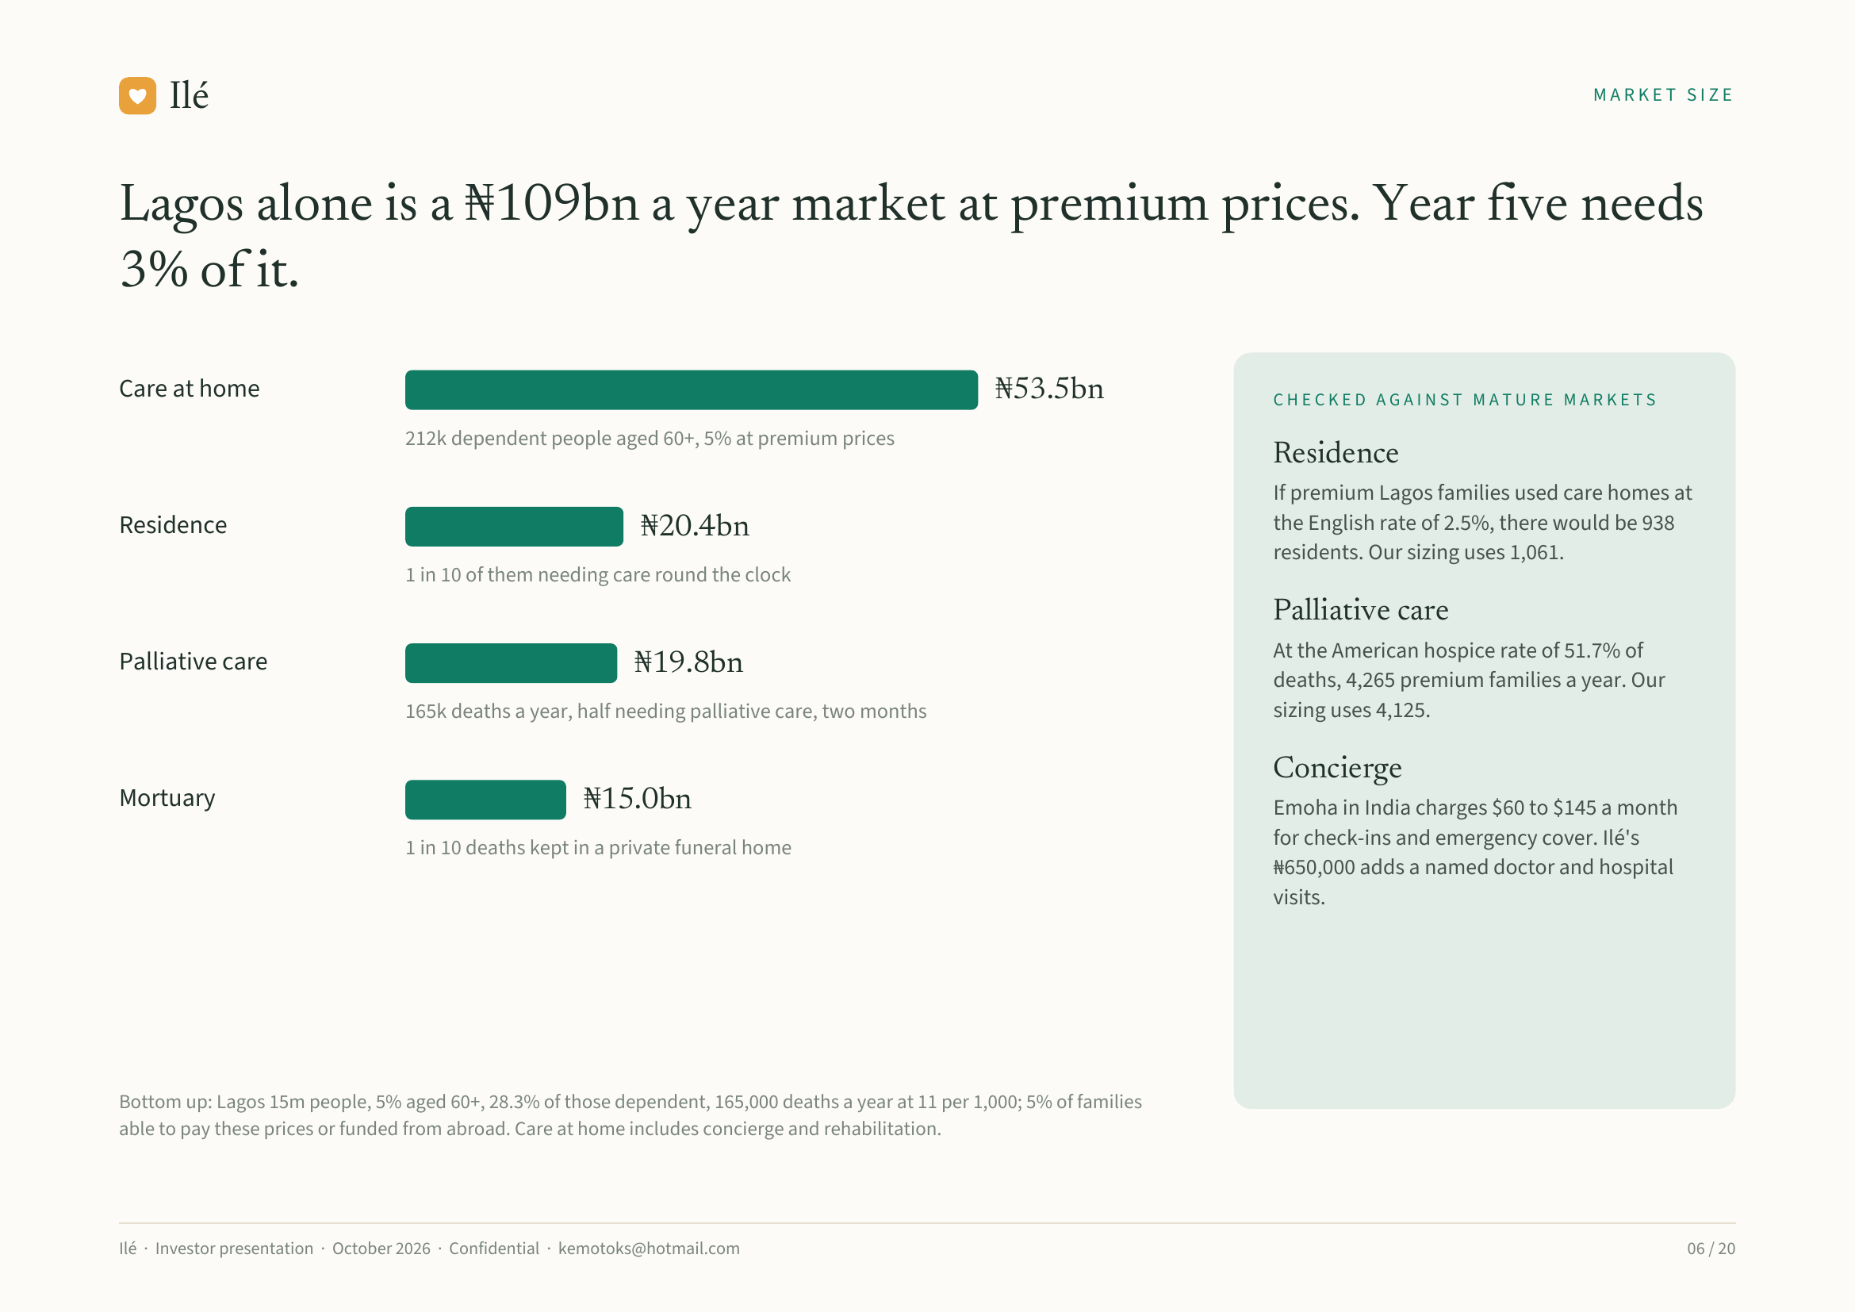
Notes:
Ilé MARKET SIZE
Lagos alone is a ₦109bn a year market at premium prices. Year five needs
3% of it.
Care at home ₦53.5bn CHECKED AGAINST MATURE MARKETS
212k dependent people aged 60+, 5% at premium prices
Residence
If premium Lagos families used care homes at
Residence ₦20.4bn the English rate of 2.5%, there would be 938
residents. Our sizing uses 1,061.
1 in 10 of them needing care round the clock
Palliative care
At the American hospice rate of 51.7% of
Palliative care ₦19.8bn deaths, 4,265 premium families a year. Our
165k deaths a year, half needing palliative care, two months sizing uses 4,125.
Concierge
Mortuary ₦15.0bn Emoha in India charges $60 to $145 a month
1 in 10 deaths kept in a private funeral home for check-ins and emergency cover. Ilé's
₦650,000 adds a named doctor and hospital
visits.
Bottom up: Lagos 15m people, 5% aged 60+, 28.3% of those dependent, 165,000 deaths a year at 11 per 1,000; 5% of families
able to pay these prices or funded from abroad. Care at home includes concierge and rehabilitation.
Ilé · Investor presentation · October 2026 · Confidential · kemotoks@hotmail.com 06 / 20

Slide 7
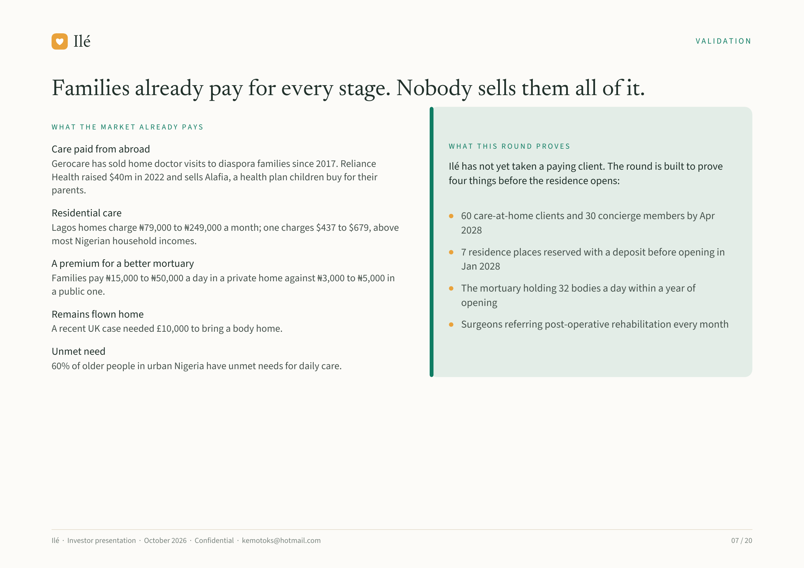
Notes:
Ilé VALIDATION
Families already pay for every stage. Nobody sells them all of it.
WHAT THE MARKET ALREADY PAYS
WHAT THIS ROUND PROVES
Care paid from abroad
Gerocare has sold home doctor visits to diaspora families since 2017. Reliance Ilé has not yet taken a paying client. The round is built to prove
Health raised $40m in 2022 and sells Alafia, a health plan children buy for their four things before the residence opens:
parents.
Residential care 60 care-at-home clients and 30 concierge members by Apr
Lagos homes charge ₦79,000 to ₦249,000 a month; one charges $437 to $679, above 2028
most Nigerian household incomes.
7 residence places reserved with a deposit before opening in
A premium for a better mortuary Jan 2028
Families pay ₦15,000 to ₦50,000 a day in a private home against ₦3,000 to ₦5,000 in
a public one. The mortuary holding 32 bodies a day within a year of
opening
Remains flown home
A recent UK case needed £10,000 to bring a body home. Surgeons referring post-operative rehabilitation every month
Unmet need
60% of older people in urban Nigeria have unmet needs for daily care.
Ilé · Investor presentation · October 2026 · Confidential · kemotoks@hotmail.com 07 / 20

Slide 8
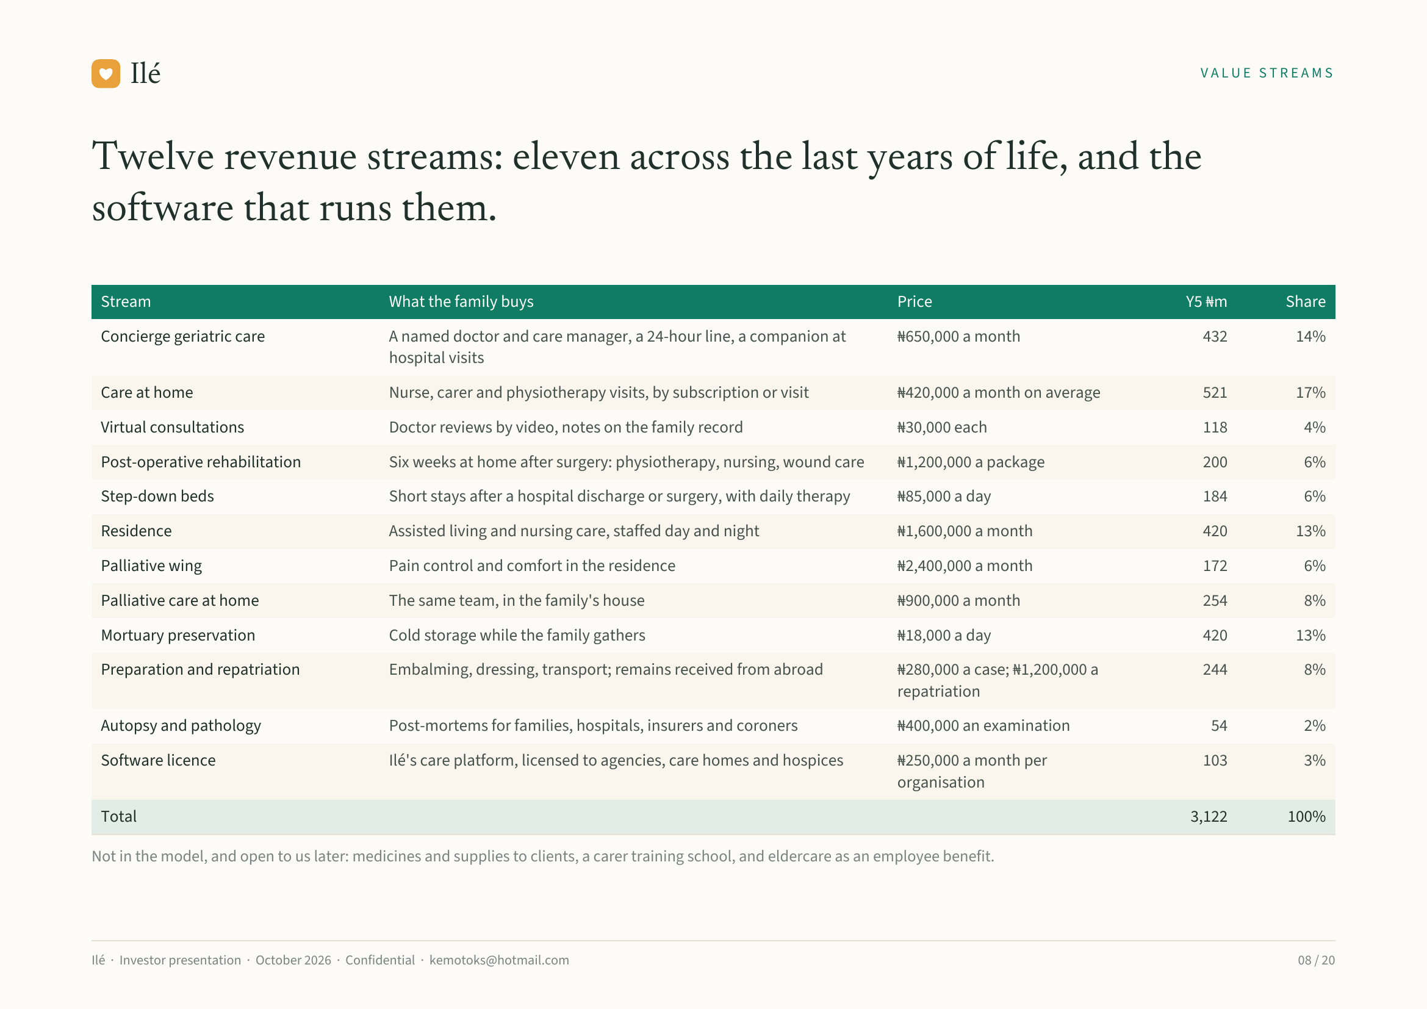
Notes:
Ilé VALUE STREAMS
Twelve revenue streams: eleven across the last years of life, and the
software that runs them.
Stream What the family buys Price Y5 ₦m Share
Concierge geriatric care A named doctor and care manager, a 24-hour line, a companion at ₦650,000 a month 432 14%
hospital visits
Care at home Nurse, carer and physiotherapy visits, by subscription or visit ₦420,000 a month on average 521 17%
Virtual consultations Doctor reviews by video, notes on the family record ₦30,000 each 118 4%
Post-operative rehabilitation Six weeks at home after surgery: physiotherapy, nursing, wound care ₦1,200,000 a package 200 6%
Step-down beds Short stays after a hospital discharge or surgery, with daily therapy ₦85,000 a day 184 6%
Residence Assisted living and nursing care, staffed day and night ₦1,600,000 a month 420 13%
Palliative wing Pain control and comfort in the residence ₦2,400,000 a month 172 6%
Palliative care at home The same team, in the family's house ₦900,000 a month 254 8%
Mortuary preservation Cold storage while the family gathers ₦18,000 a day 420 13%
Preparation and repatriation Embalming, dressing, transport; remains received from abroad ₦280,000 a case; ₦1,200,000 a 244 8%
repatriation
Autopsy and pathology Post-mortems for families, hospitals, insurers and coroners ₦400,000 an examination 54 2%
Software licence Ilé's care platform, licensed to agencies, care homes and hospices ₦250,000 a month per 103 3%
organisation
Total 3,122 100%
Not in the model, and open to us later: medicines and supplies to clients, a carer training school, and eldercare as an employee benefit.
Ilé · Investor presentation · October 2026 · Confidential · kemotoks@hotmail.com 08 / 20

Slide 9
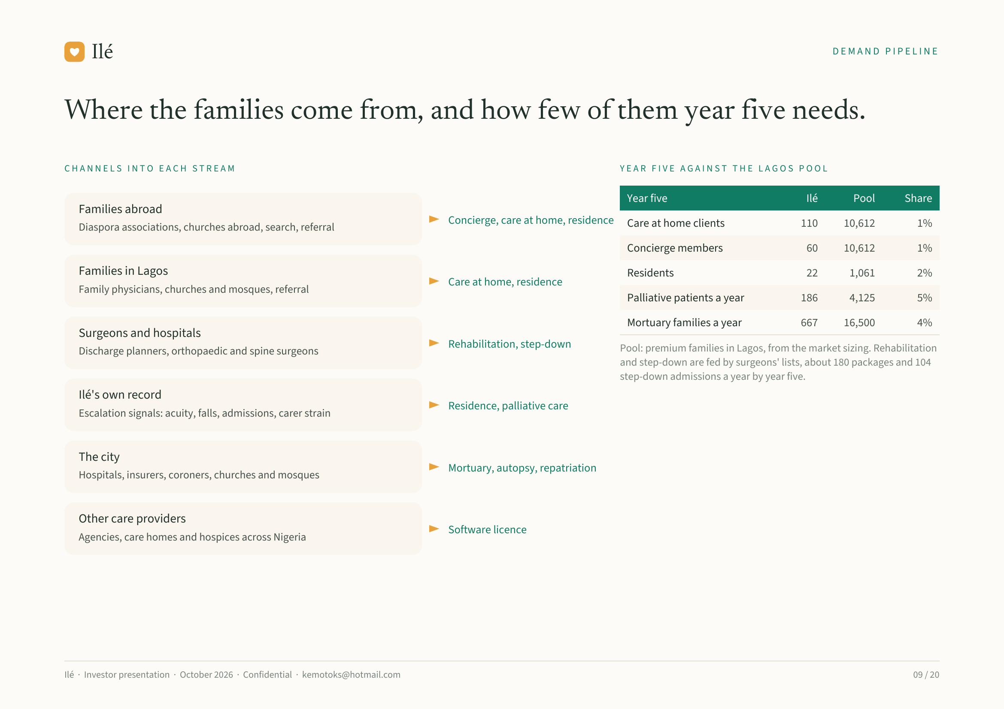
Notes:
Ilé DEMAND PIPELINE
Where the families come from, and how few of them year five needs.
CHANNELS INTO EACH STREAM YEAR FIVE AGAINST THE LAGOS POOL
Year five Ilé Pool Share
Families abroad
Concierge, care at home, residence Care at home clients 110 10,612 1%
Diaspora associations, churches abroad, search, referral
Concierge members 60 10,612 1%
Families in Lagos Residents 22 1,061 2%
Care at home, residence
Family physicians, churches and mosques, referral
Palliative patients a year 186 4,125 5%
Mortuary families a year 667 16,500 4%
Surgeons and hospitals
Rehabilitation, step-down Pool: premium families in Lagos, from the market sizing. Rehabilitation
Discharge planners, orthopaedic and spine surgeons
and step-down are fed by surgeons' lists, about 180 packages and 104
step-down admissions a year by year five.
Ilé's own record
Residence, palliative care
Escalation signals: acuity, falls, admissions, carer strain
The city
Mortuary, autopsy, repatriation
Hospitals, insurers, coroners, churches and mosques
Other care providers
Software licence
Agencies, care homes and hospices across Nigeria
Ilé · Investor presentation · October 2026 · Confidential · kemotoks@hotmail.com 09 / 20

Slide 10
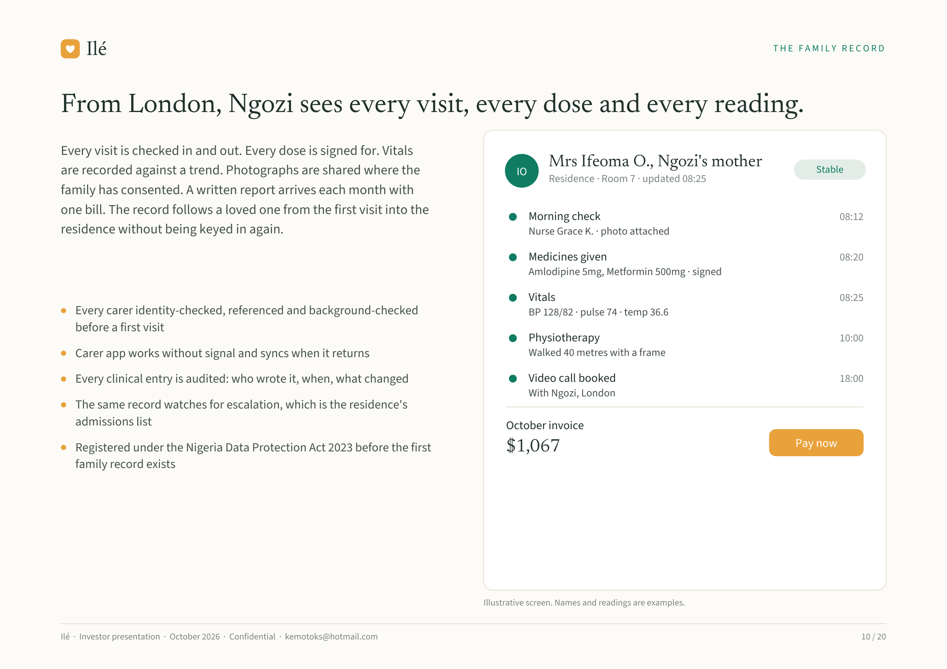
Notes:
Ilé THE FAMILY RECORD
From London, Ngozi sees every visit, every dose and every reading.
Every visit is checked in and out. Every dose is signed for. Vitals
Mrs Ifeoma O., Ngozi's mother
are recorded against a trend. Photographs are shared where the IO Stable
Residence · Room 7 · updated 08:25
family has consented. A written report arrives each month with
one bill. The record follows a loved one from the first visit into the Morning check 08:12
residence without being keyed in again. Nurse Grace K. · photo attached
Medicines given 08:20
Amlodipine 5mg, Metformin 500mg · signed
Vitals 08:25
Every carer identity-checked, referenced and background-checked BP 128/82 · pulse 74 · temp 36.6
before a first visit
Physiotherapy 10:00
Carer app works without signal and syncs when it returns Walked 40 metres with a frame
Every clinical entry is audited: who wrote it, when, what changed Video call booked 18:00
With Ngozi, London
The same record watches for escalation, which is the residence's
admissions list October invoice
Registered under the Nigeria Data Protection Act 2023 before the first $1,067 Pay now
family record exists
Illustrative screen. Names and readings are examples.
Ilé · Investor presentation · October 2026 · Confidential · kemotoks@hotmail.com 10 / 20

Slide 11
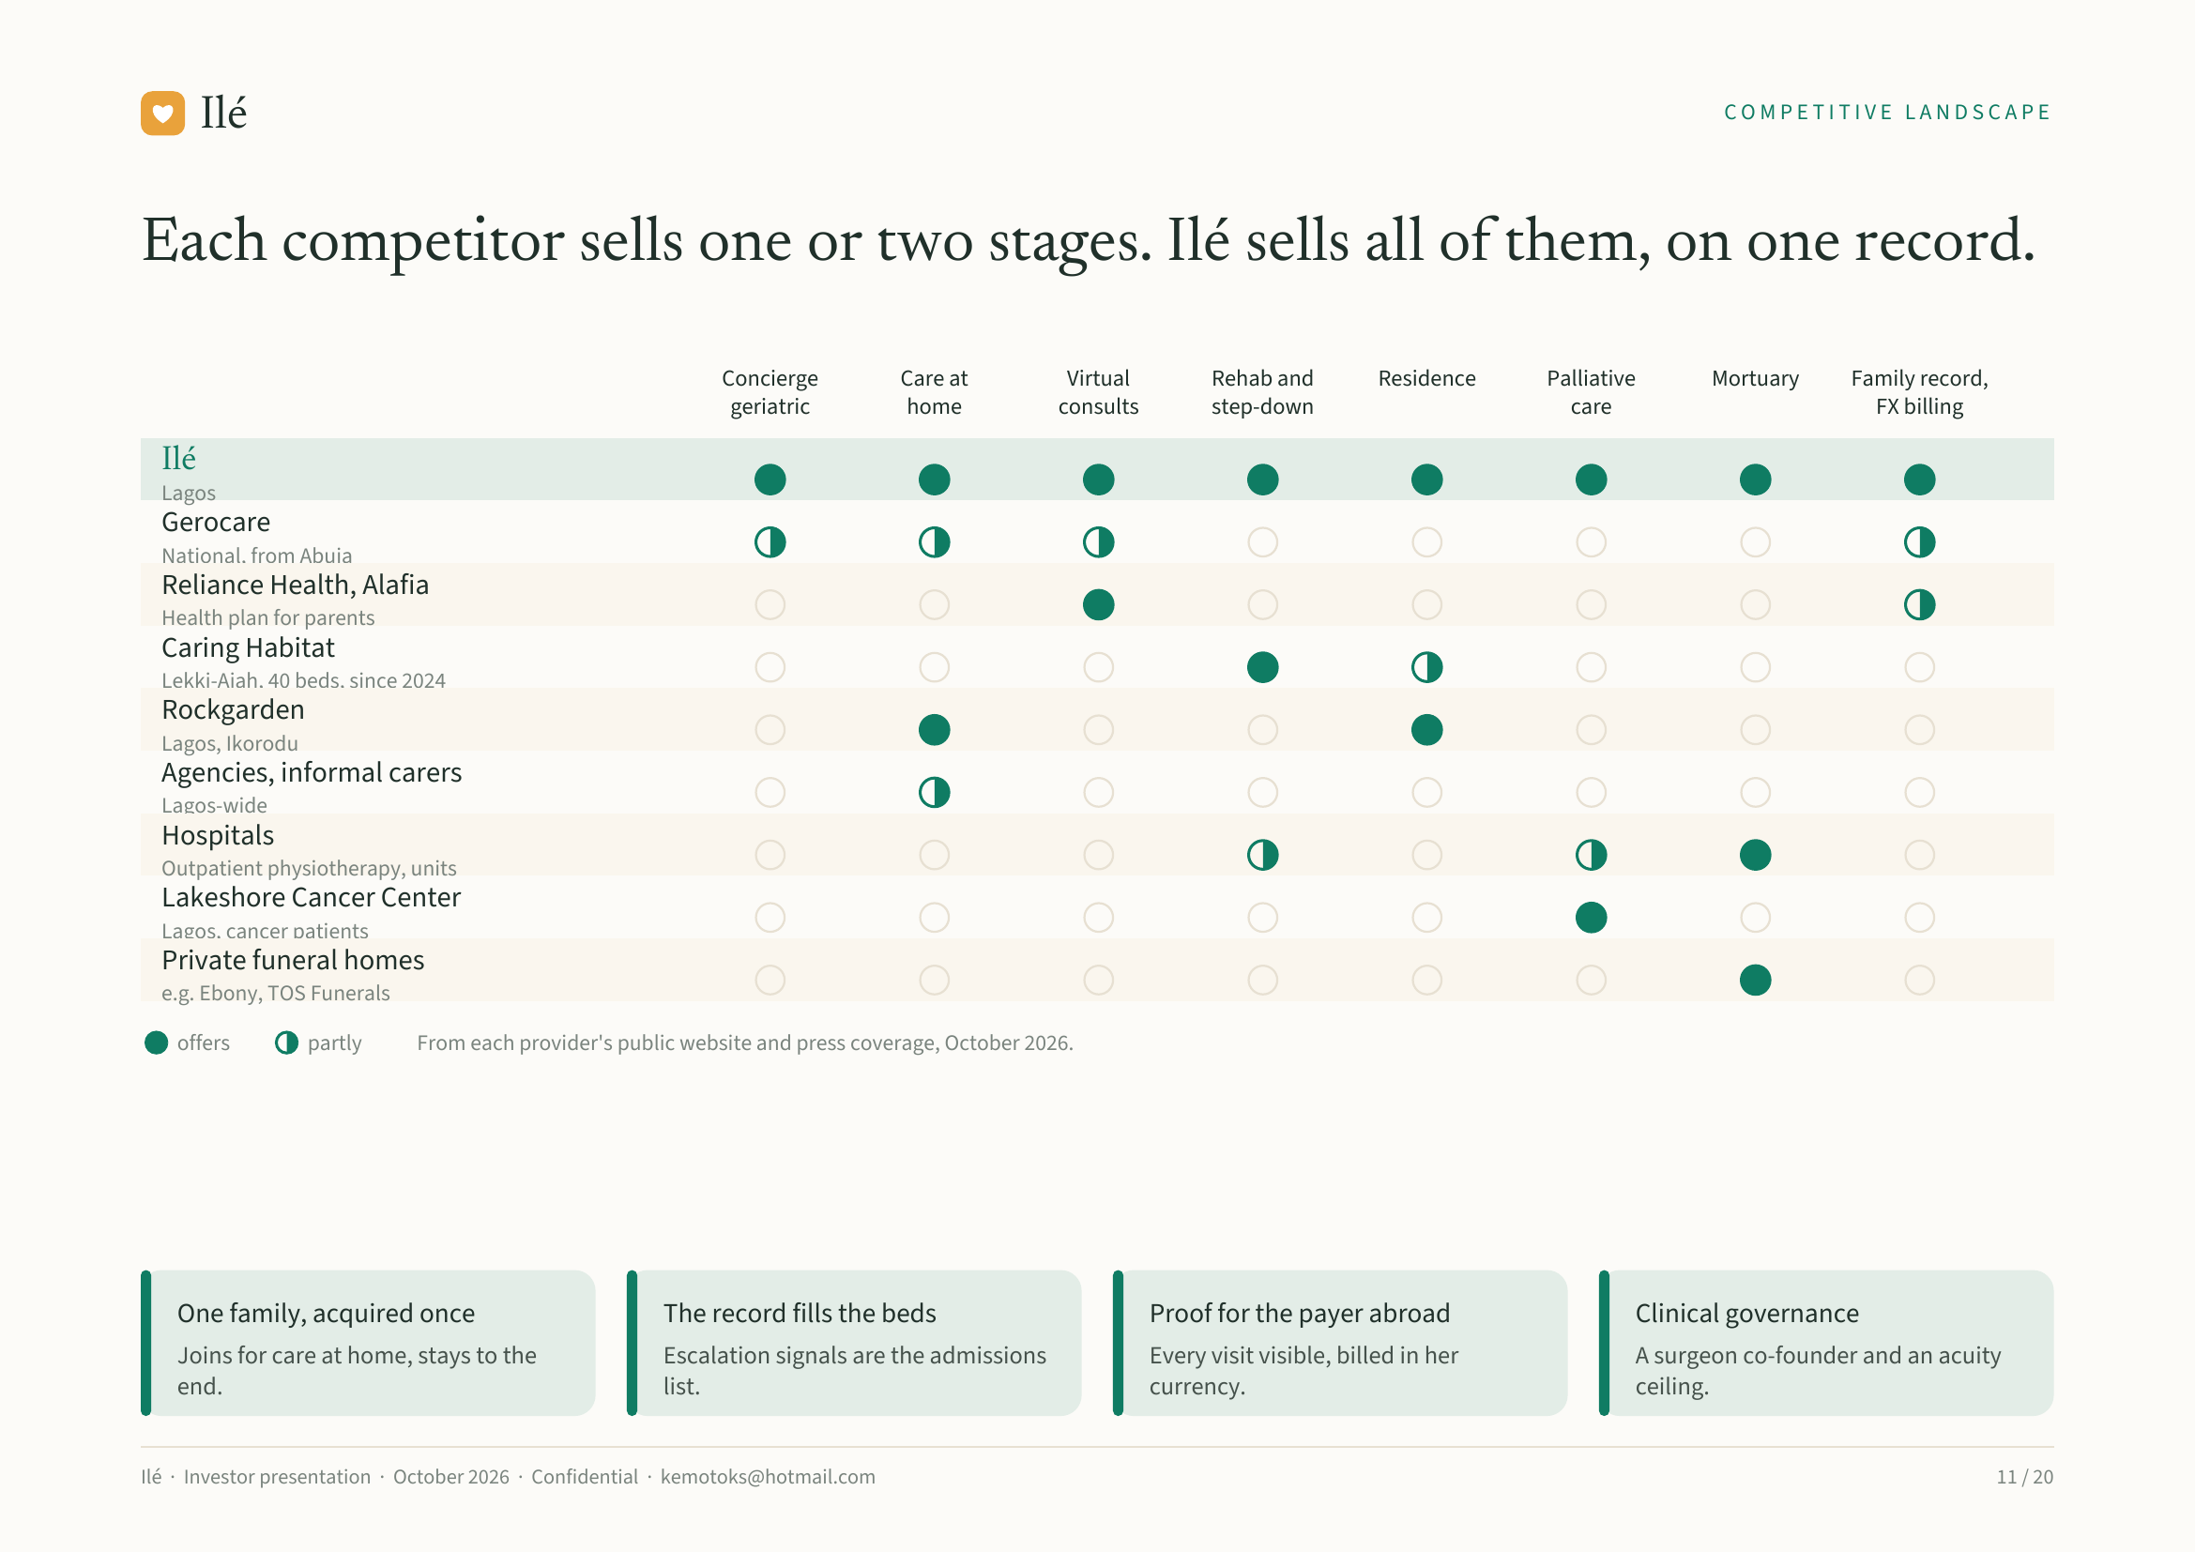
Notes:
Ilé COMPETITIVE LANDSCAPE
Each competitor sells one or two stages. Ilé sells all of them, on one record.
Concierge Care at Virtual Rehab and Residence Palliative Mortuary Family record,
geriatric home consults step-down care FX billing
Ilé
Lagos
Gerocare
National, from Abuja
Reliance Health, Alafia
Health plan for parents
Caring Habitat
Lekki-Ajah, 40 beds, since 2024
Rockgarden
Lagos, Ikorodu
Agencies, informal carers
Lagos-wide
Hospitals
Outpatient physiotherapy, units
Lakeshore Cancer Center
Lagos, cancer patients
Private funeral homes
e.g. Ebony, TOS Funerals
offers partly From each provider's public website and press coverage, October 2026.
One family, acquired once The record fills the beds Proof for the payer abroad Clinical governance
Joins for care at home, stays to the Escalation signals are the admissions Every visit visible, billed in her A surgeon co-founder and an acuity
end. list. currency. ceiling.
Ilé · Investor presentation · October 2026 · Confidential · kemotoks@hotmail.com 11 / 20

Slide 12
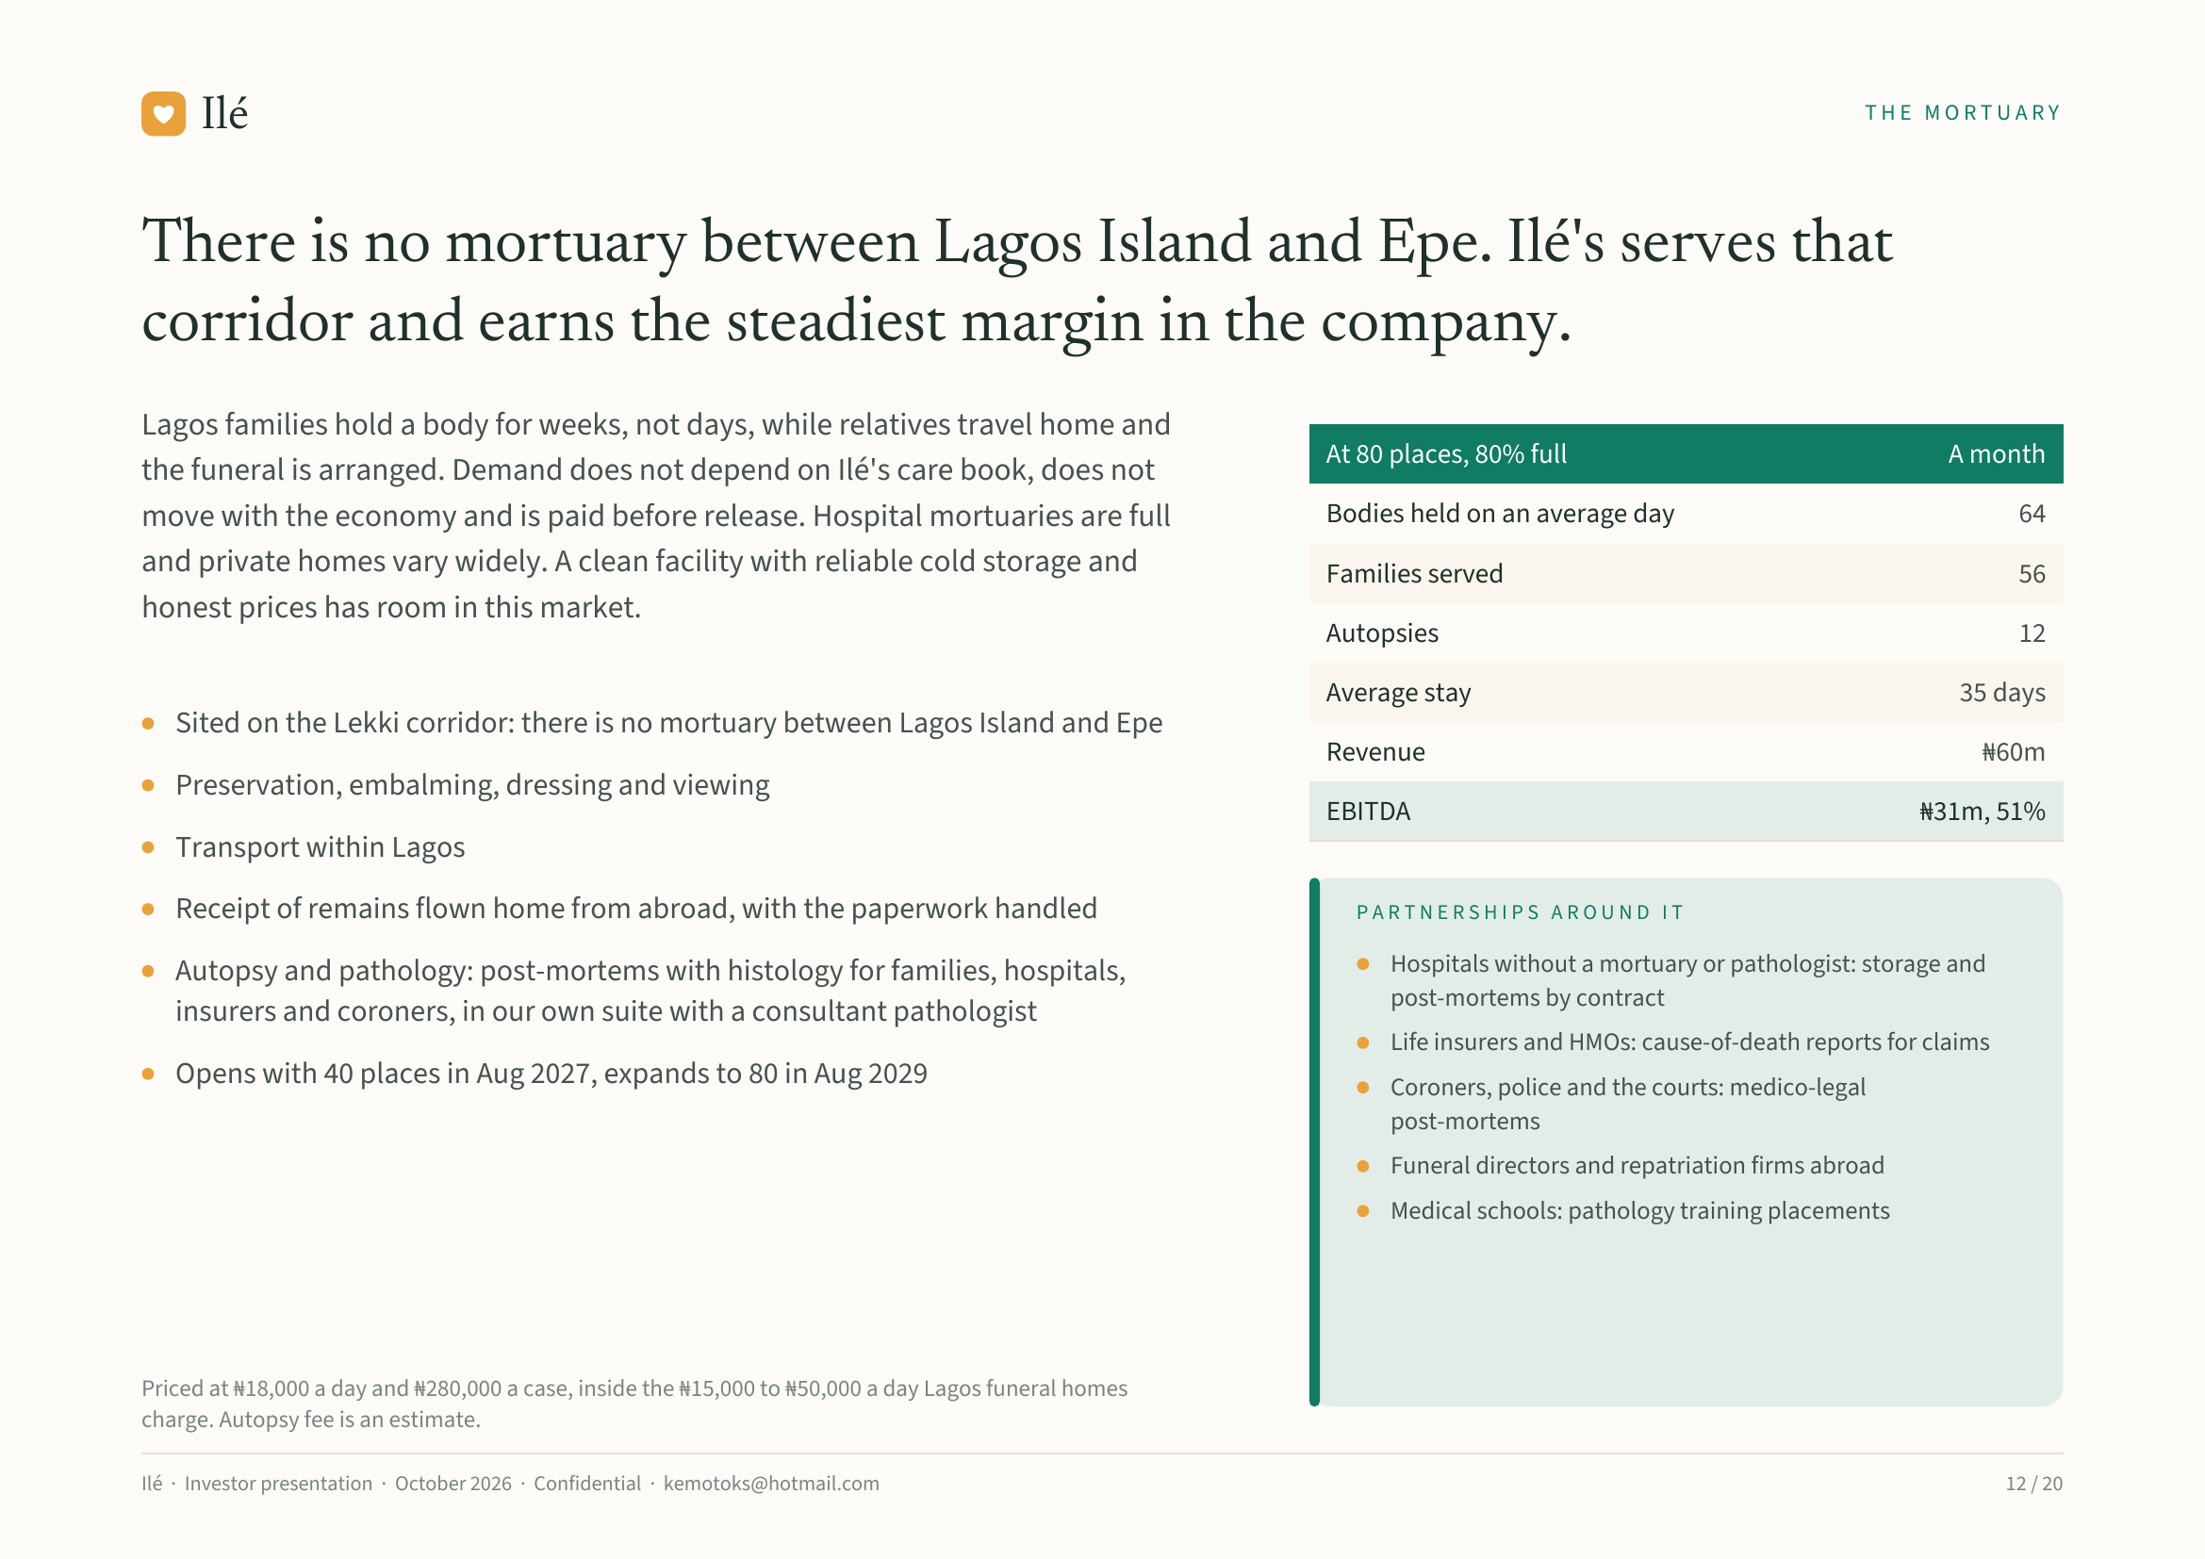
Notes:
Ilé THE MORTUARY
There is no mortuary between Lagos Island and Epe. Ilé's serves that
corridor and earns the steadiest margin in the company.
Lagos families hold a body for weeks, not days, while relatives travel home and
At 80 places, 80% full A month
the funeral is arranged. Demand does not depend on Ilé's care book, does not
move with the economy and is paid before release. Hospital mortuaries are full Bodies held on an average day 64
and private homes vary widely. A clean facility with reliable cold storage and Families served 56
honest prices has room in this market.
Autopsies 12
Average stay 35 days
Sited on the Lekki corridor: there is no mortuary between Lagos Island and Epe
Revenue ₦60m
Preservation, embalming, dressing and viewing
EBITDA ₦31m, 51%
Transport within Lagos
Receipt of remains flown home from abroad, with the paperwork handled PARTNERSHIPS AROUND IT
Autopsy and pathology: post-mortems with histology for families, hospitals, Hospitals without a mortuary or pathologist: storage and
post-mortems by contract
insurers and coroners, in our own suite with a consultant pathologist
Life insurers and HMOs: cause-of-death reports for claims
Opens with 40 places in Aug 2027, expands to 80 in Aug 2029 Coroners, police and the courts: medico-legal
post-mortems
Funeral directors and repatriation firms abroad
Medical schools: pathology training placements
Priced at ₦18,000 a day and ₦280,000 a case, inside the ₦15,000 to ₦50,000 a day Lagos funeral homes
charge. Autopsy fee is an estimate.
Ilé · Investor presentation · October 2026 · Confidential · kemotoks@hotmail.com 12 / 20

Slide 13
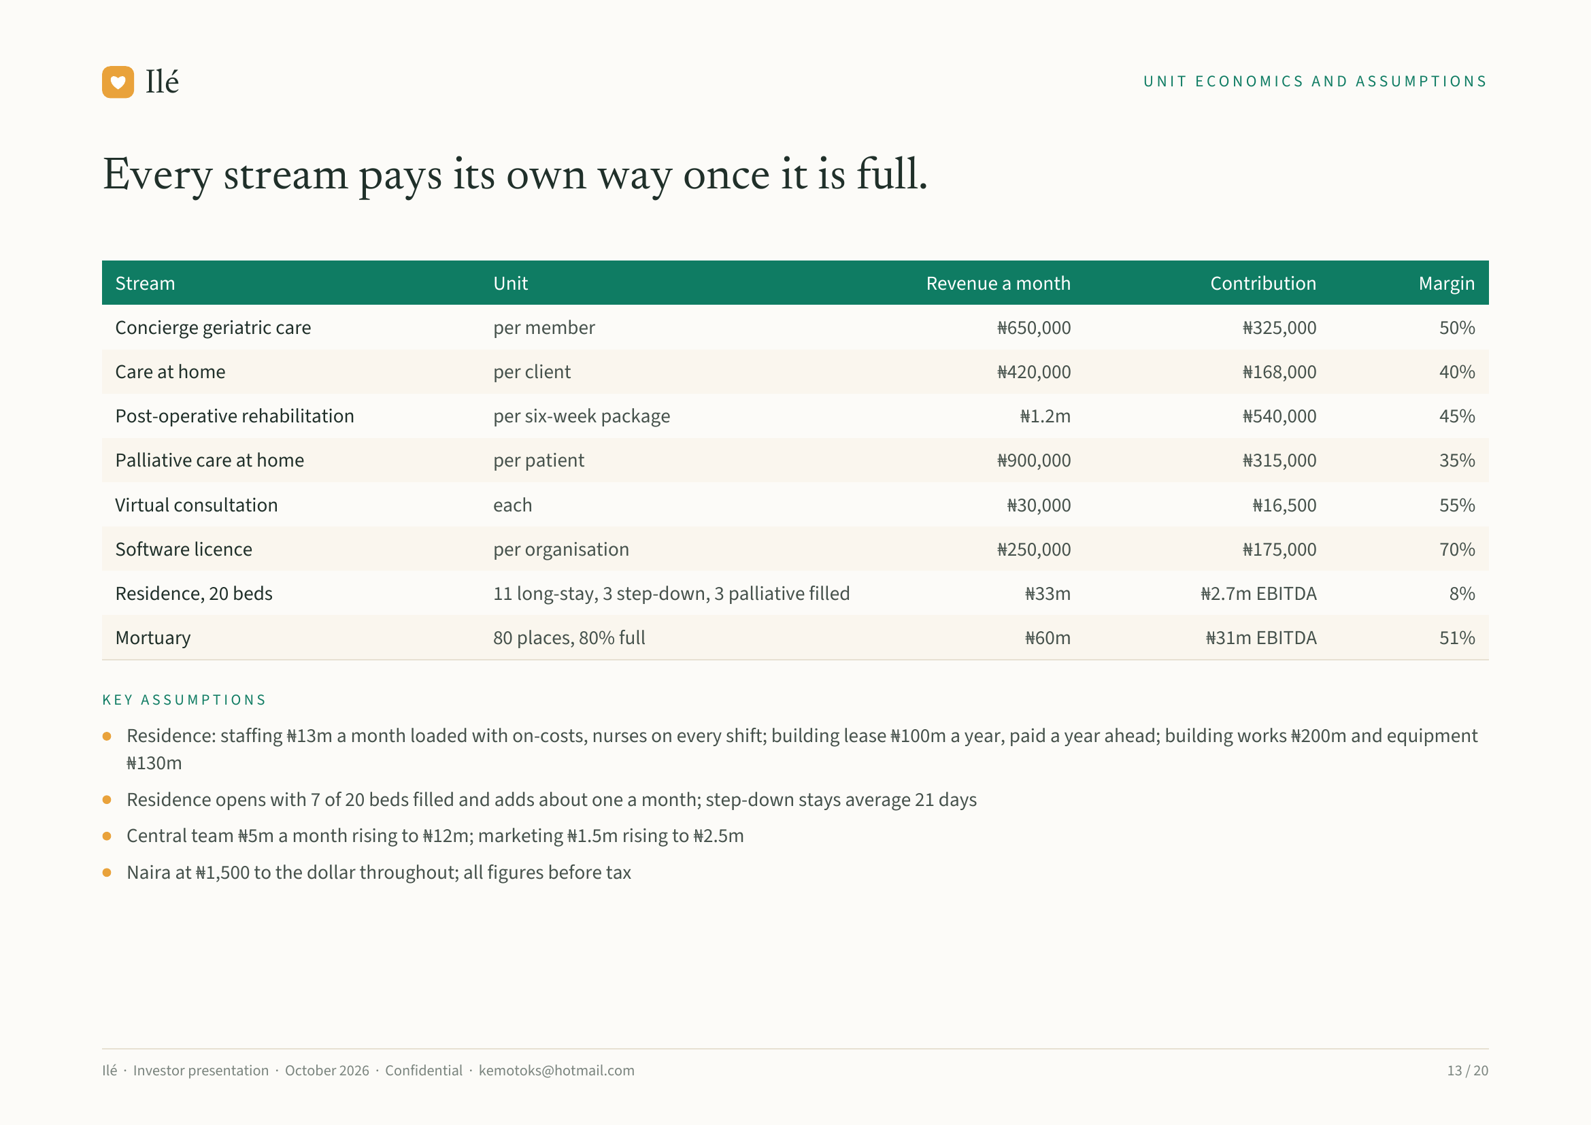
Notes:
Ilé UNIT ECONOMICS AND ASSUMPTIONS
Every stream pays its own way once it is full.
Stream Unit Revenue a month Contribution Margin
Concierge geriatric care per member ₦650,000 ₦325,000 50%
Care at home per client ₦420,000 ₦168,000 40%
Post-operative rehabilitation per six-week package ₦1.2m ₦540,000 45%
Palliative care at home per patient ₦900,000 ₦315,000 35%
Virtual consultation each ₦30,000 ₦16,500 55%
Software licence per organisation ₦250,000 ₦175,000 70%
Residence, 20 beds 11 long-stay, 3 step-down, 3 palliative filled ₦33m ₦2.7m EBITDA 8%
Mortuary 80 places, 80% full ₦60m ₦31m EBITDA 51%
KEY ASSUMPTIONS
Residence: staffing ₦13m a month loaded with on-costs, nurses on every shift; building lease ₦100m a year, paid a year ahead; building works ₦200m and equipment
₦130m
Residence opens with 7 of 20 beds filled and adds about one a month; step-down stays average 21 days
Central team ₦5m a month rising to ₦12m; marketing ₦1.5m rising to ₦2.5m
Naira at ₦1,500 to the dollar throughout; all figures before tax
Ilé · Investor presentation · October 2026 · Confidential · kemotoks@hotmail.com 13 / 20

Slide 14
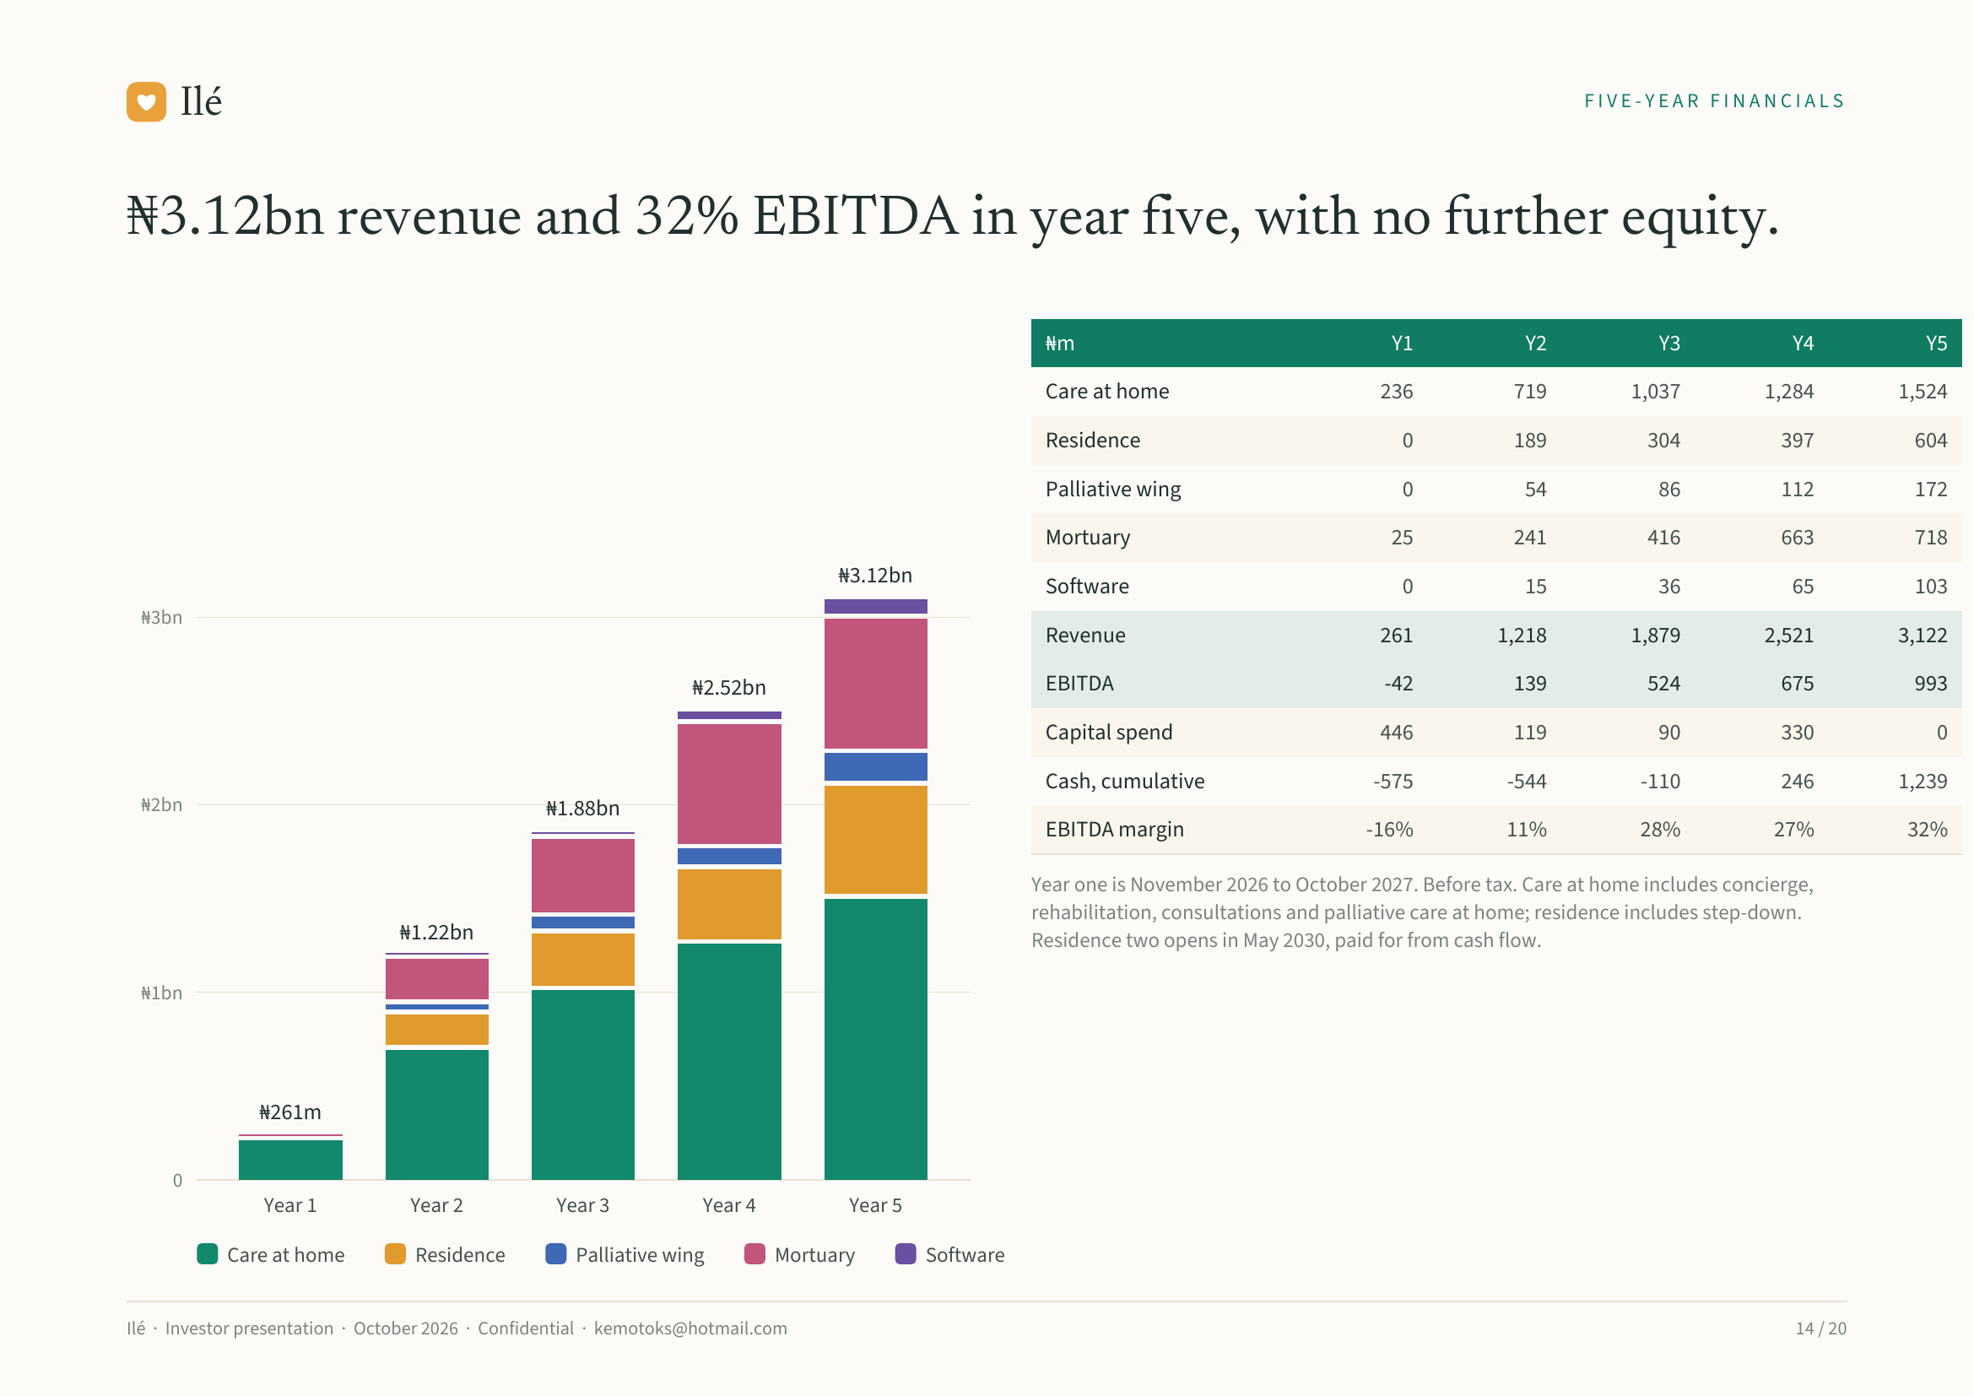
Notes:
Ilé FIVE-YEAR FINANCIALS
₦3.12bn revenue and 32% EBITDA in year five, with no further equity.
₦m Y1 Y2 Y3 Y4 Y5
Care at home 236 719 1,037 1,284 1,524
Residence 0 189 304 397 604
Palliative wing 0 54 86 112 172
Mortuary 25 241 416 663 718
₦3.12bn Software 0 15 36 65 103
₦3bn
Revenue 261 1,218 1,879 2,521 3,122
₦2.52bn EBITDA -42 139 524 675 993
Capital spend 446 119 90 330 0
Cash, cumulative -575 -544 -110 246 1,239
₦2bn ₦1.88bn
EBITDA margin -16% 11% 28% 27% 32%
Year one is November 2026 to October 2027. Before tax. Care at home includes concierge,
rehabilitation, consultations and palliative care at home; residence includes step-down.
₦1.22bn Residence two opens in May 2030, paid for from cash flow.
₦1bn
₦261m
0
Year 1 Year 2 Year 3 Year 4 Year 5
Care at home Residence Palliative wing Mortuary Software
Ilé · Investor presentation · October 2026 · Confidential · kemotoks@hotmail.com 14 / 20

Slide 15
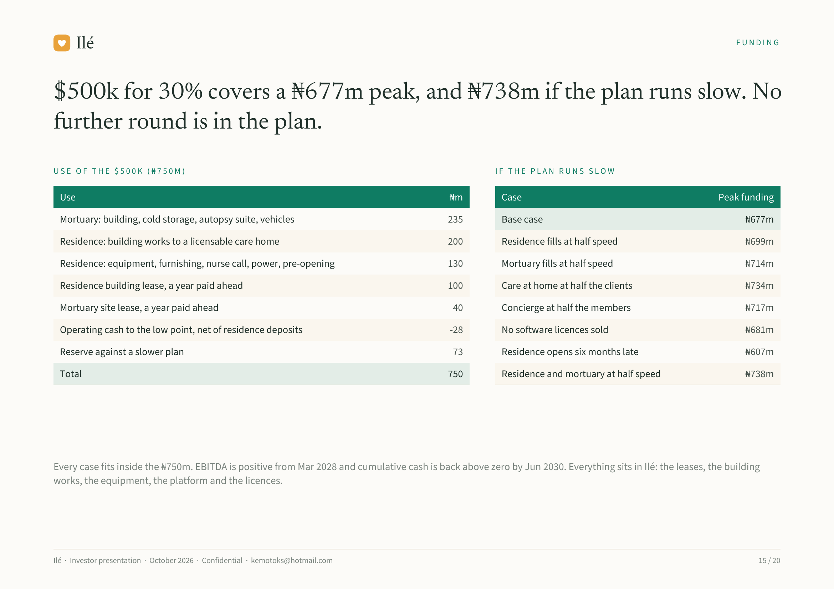
Notes:
Ilé FUNDING
$500k for 30% covers a ₦677m peak, and ₦738m if the plan runs slow. No
further round is in the plan.
USE OF THE $500K (₦750M) IF THE PLAN RUNS SLOW
Use ₦m Case Peak funding
Mortuary: building, cold storage, autopsy suite, vehicles 235 Base case ₦677m
Residence: building works to a licensable care home 200 Residence fills at half speed ₦699m
Residence: equipment, furnishing, nurse call, power, pre-opening 130 Mortuary fills at half speed ₦714m
Residence building lease, a year paid ahead 100 Care at home at half the clients ₦734m
Mortuary site lease, a year paid ahead 40 Concierge at half the members ₦717m
Operating cash to the low point, net of residence deposits -28 No software licences sold ₦681m
Reserve against a slower plan 73 Residence opens six months late ₦607m
Total 750 Residence and mortuary at half speed ₦738m
Every case fits inside the ₦750m. EBITDA is positive from Mar 2028 and cumulative cash is back above zero by Jun 2030. Everything sits in Ilé: the leases, the building
works, the equipment, the platform and the licences.
Ilé · Investor presentation · October 2026 · Confidential · kemotoks@hotmail.com 15 / 20

Slide 16
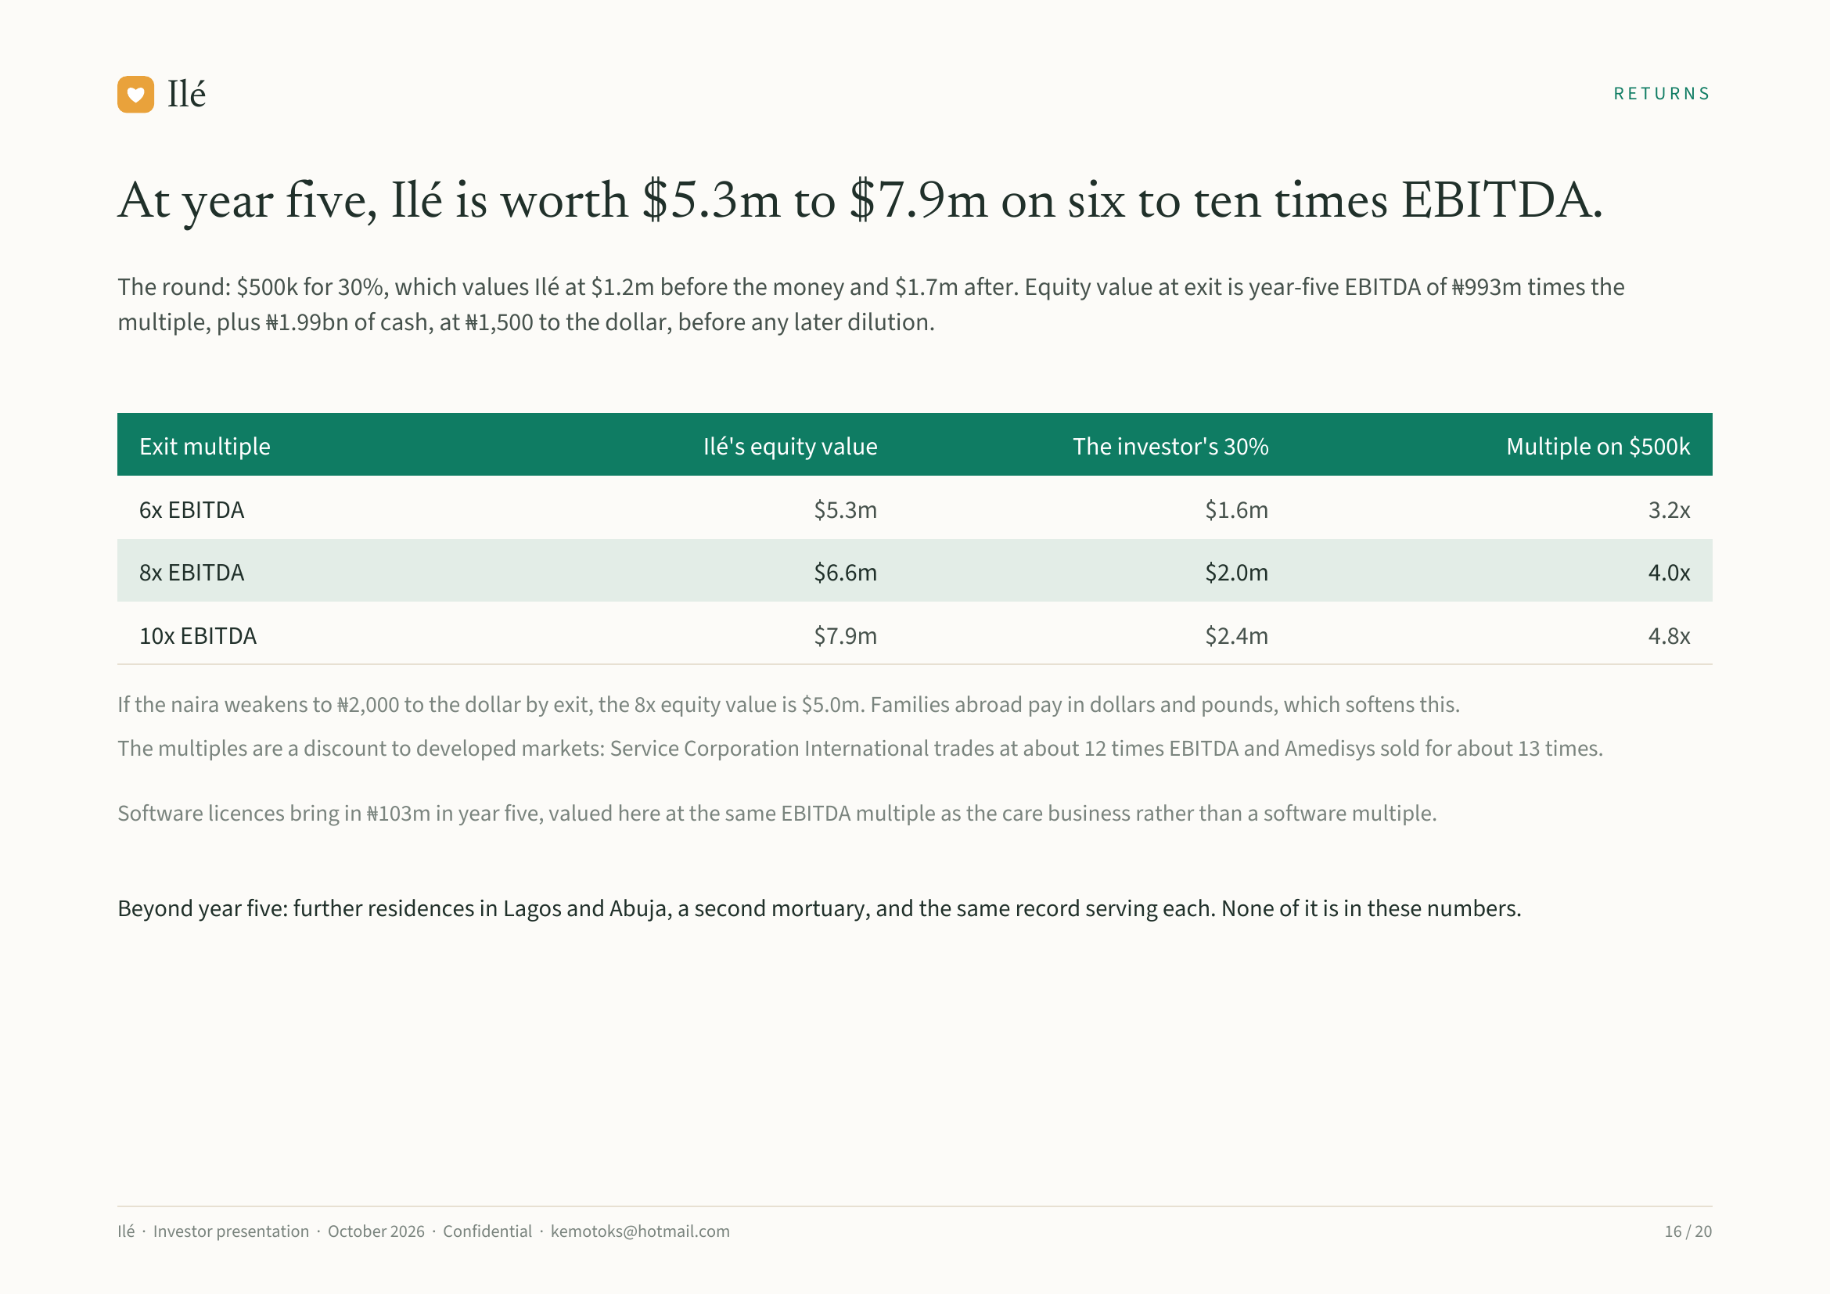
Notes:
Ilé RETURNS
At year five, Ilé is worth $5.3m to $7.9m on six to ten times EBITDA.
The round: $500k for 30%, which values Ilé at $1.2m before the money and $1.7m after. Equity value at exit is year-five EBITDA of ₦993m times the
multiple, plus ₦1.99bn of cash, at ₦1,500 to the dollar, before any later dilution.
Exit multiple Ilé's equity value The investor's 30% Multiple on $500k
6x EBITDA $5.3m $1.6m 3.2x
8x EBITDA $6.6m $2.0m 4.0x
10x EBITDA $7.9m $2.4m 4.8x
If the naira weakens to ₦2,000 to the dollar by exit, the 8x equity value is $5.0m. Families abroad pay in dollars and pounds, which softens this.
The multiples are a discount to developed markets: Service Corporation International trades at about 12 times EBITDA and Amedisys sold for about 13 times.
Software licences bring in ₦103m in year five, valued here at the same EBITDA multiple as the care business rather than a software multiple.
Beyond year five: further residences in Lagos and Abuja, a second mortuary, and the same record serving each. None of it is in these numbers.
Ilé · Investor presentation · October 2026 · Confidential · kemotoks@hotmail.com 16 / 20

Slide 17
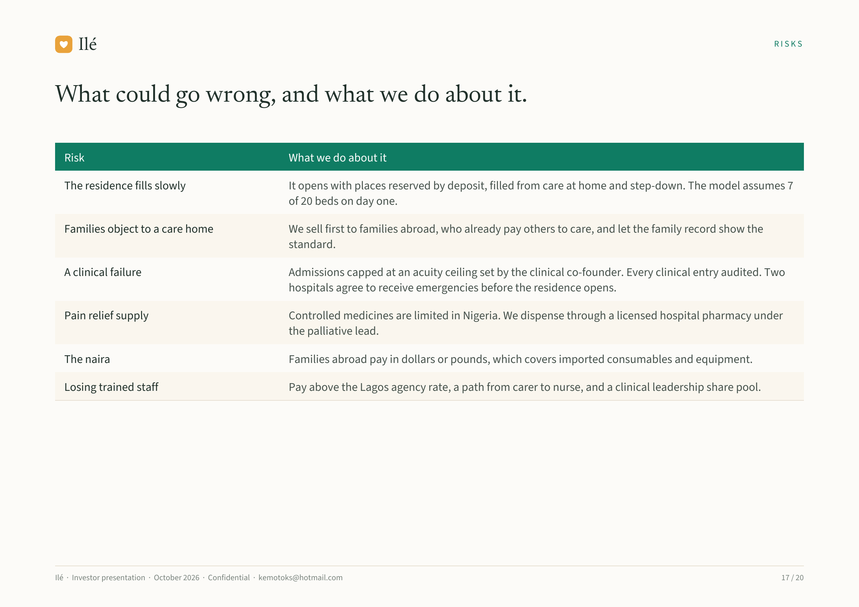
Notes:
Ilé RISKS
What could go wrong, and what we do about it.
Risk What we do about it
The residence fills slowly It opens with places reserved by deposit, filled from care at home and step-down. The model assumes 7
of 20 beds on day one.
Families object to a care home We sell first to families abroad, who already pay others to care, and let the family record show the
standard.
A clinical failure Admissions capped at an acuity ceiling set by the clinical co-founder. Every clinical entry audited. Two
hospitals agree to receive emergencies before the residence opens.
Pain relief supply Controlled medicines are limited in Nigeria. We dispense through a licensed hospital pharmacy under
the palliative lead.
The naira Families abroad pay in dollars or pounds, which covers imported consumables and equipment.
Losing trained staff Pay above the Lagos agency rate, a path from carer to nurse, and a clinical leadership share pool.
Ilé · Investor presentation · October 2026 · Confidential · kemotoks@hotmail.com 17 / 20

Slide 18
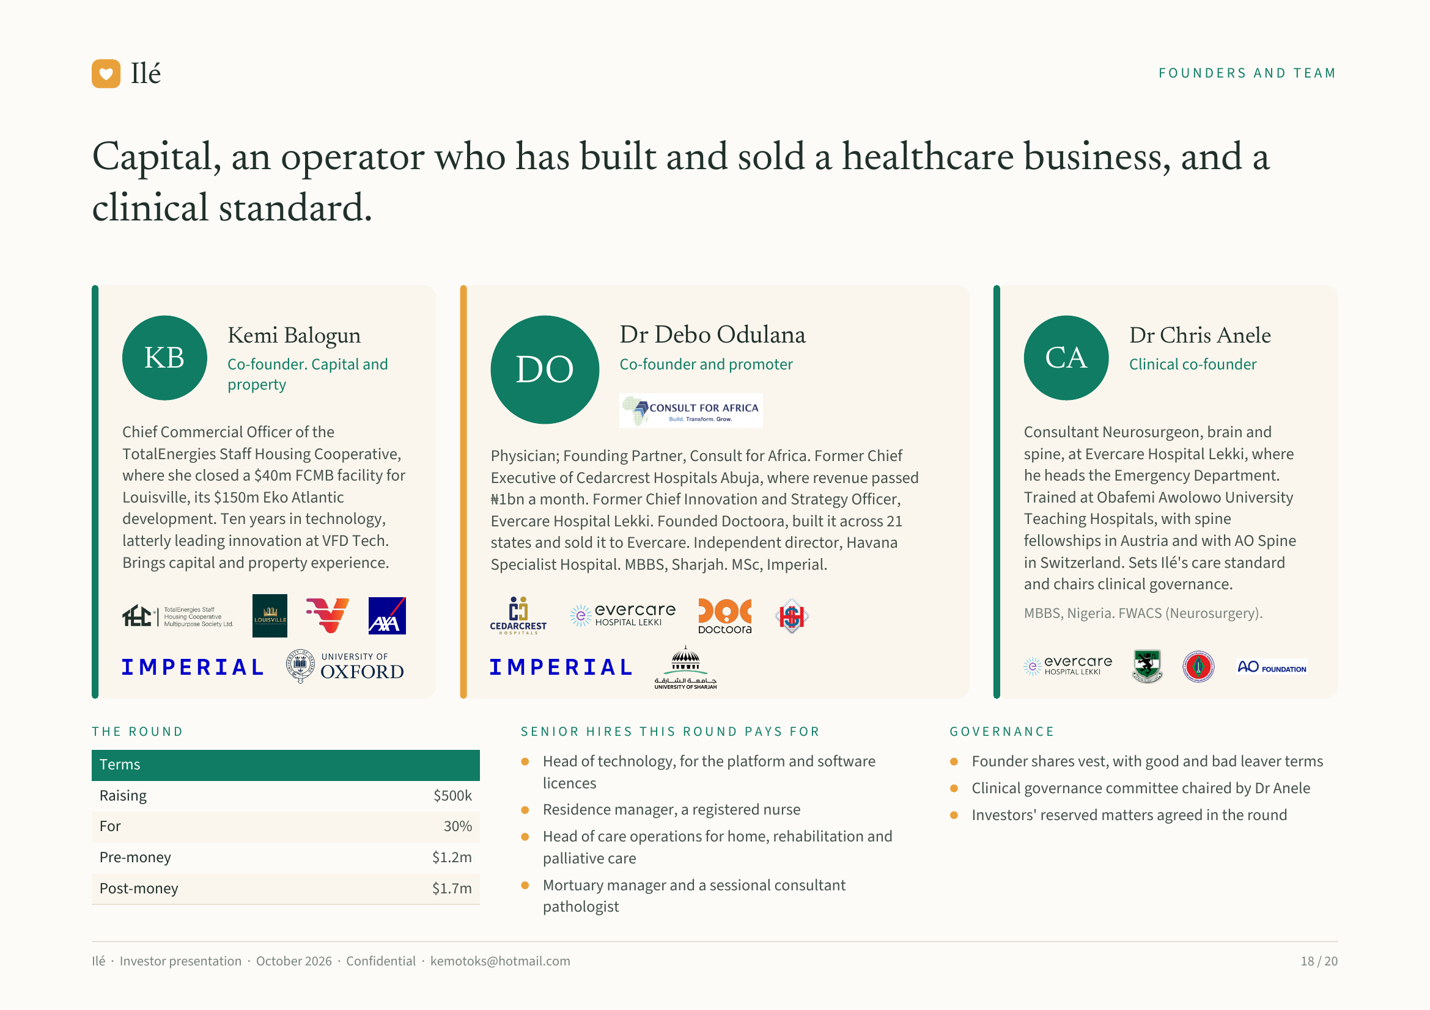
Notes:
Ilé FOUNDERS AND TEAM
Capital, an operator who has built and sold a healthcare business, and a
clinical standard.
Kemi Balogun Dr Debo Odulana Dr Chris Anele
KB Co-founder. Capital and
DO Co-founder and promoter CA Clinical co-founder
property
Chief Commercial Officer of the Consultant Neurosurgeon, brain and
TotalEnergies Staff Housing Cooperative, Physician; Founding Partner, Consult for Africa. Former Chief spine, at Evercare Hospital Lekki, where
where she closed a $40m FCMB facility for Executive of Cedarcrest Hospitals Abuja, where revenue passed he heads the Emergency Department.
Louisville, its $150m Eko Atlantic ₦1bn a month. Former Chief Innovation and Strategy Officer, Trained at Obafemi Awolowo University
development. Ten years in technology, Evercare Hospital Lekki. Founded Doctoora, built it across 21 Teaching Hospitals, with spine
latterly leading innovation at VFD Tech. states and sold it to Evercare. Independent director, Havana fellowships in Austria and with AO Spine
Brings capital and property experience. Specialist Hospital. MBBS, Sharjah. MSc, Imperial. in Switzerland. Sets Ilé's care standard
and chairs clinical governance.
MBBS, Nigeria. FWACS (Neurosurgery).
THE ROUND SENIOR HIRES THIS ROUND PAYS FOR GOVERNANCE
Terms Head of technology, for the platform and software Founder shares vest, with good and bad leaver terms
licences Clinical governance committee chaired by Dr Anele
Raising $500k
Residence manager, a registered nurse Investors' reserved matters agreed in the round
For 30%
Head of care operations for home, rehabilitation and
Pre-money $1.2m palliative care
Post-money $1.7m Mortuary manager and a sessional consultant
pathologist
Ilé · Investor presentation · October 2026 · Confidential · kemotoks@hotmail.com 18 / 20

Slide 19
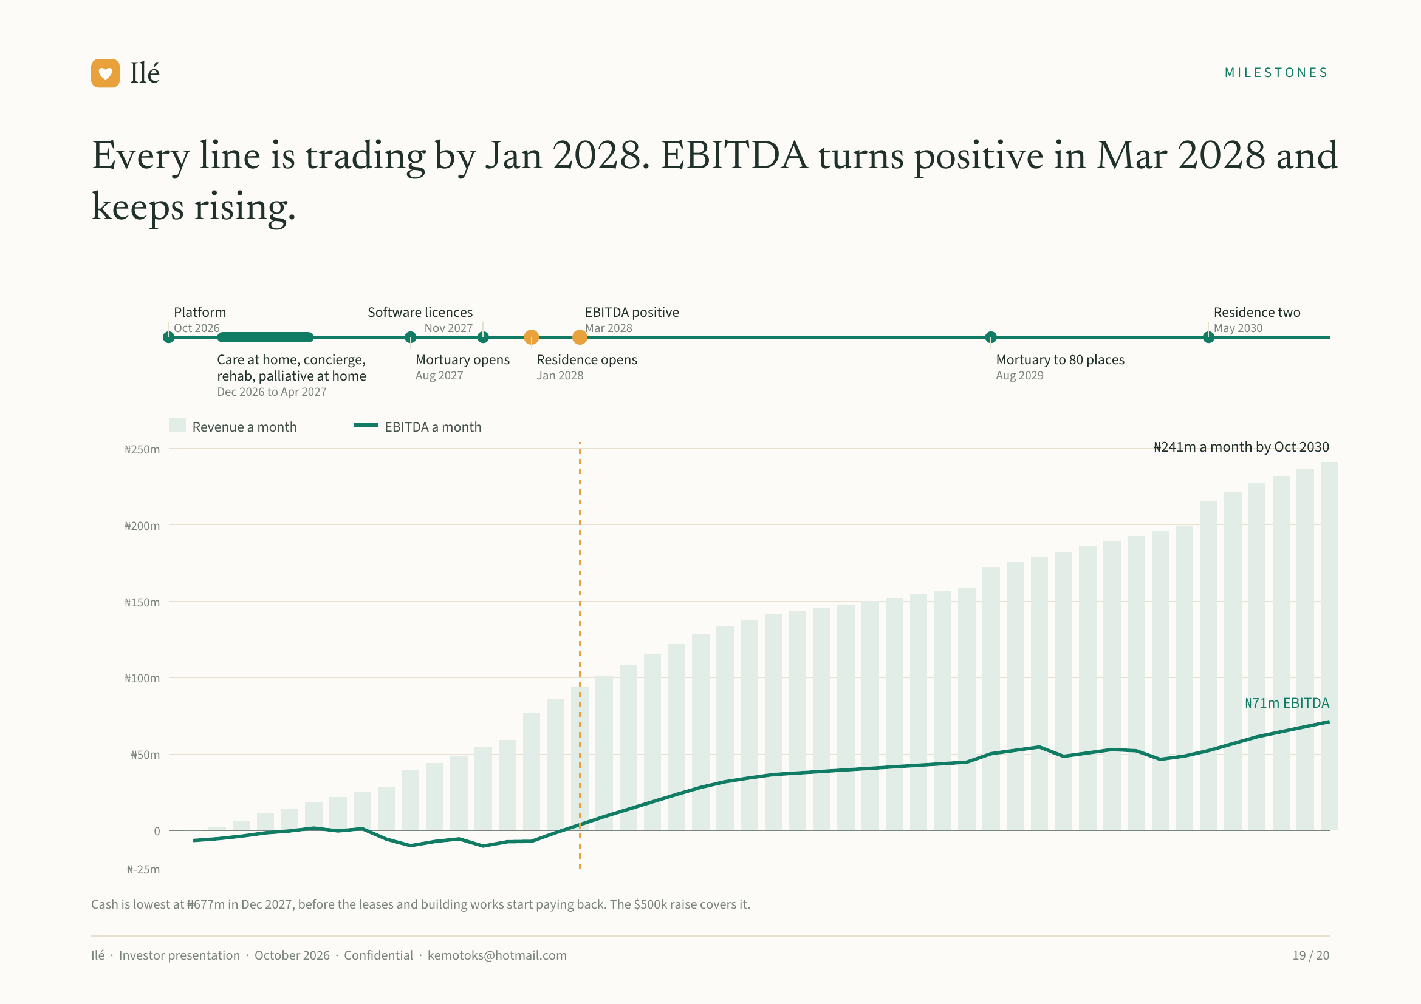
Notes:
Ilé MILESTONES
Every line is trading by Jan 2028. EBITDA turns positive in Mar 2028 and
keeps rising.
Platform Software licences EBITDA positive Residence two
Oct 2026 Nov 2027 Mar 2028 May 2030
Care at home, concierge, Mortuary opens Residence opens Mortuary to 80 places
rehab, palliative at home Aug 2027 Jan 2028 Aug 2029
Dec 2026 to Apr 2027
Revenue a month EBITDA a month
₦250m ₦241m a month by Oct 2030
₦200m
₦150m
₦100m
₦71m EBITDA
₦50m
0
₦-25m
Cash is lowest at ₦677m in Dec 2027, before the leases and building works start paying back. The $500k raise covers it.
Ilé · Investor presentation · October 2026 · Confidential · kemotoks@hotmail.com 19 / 20

Slide 20
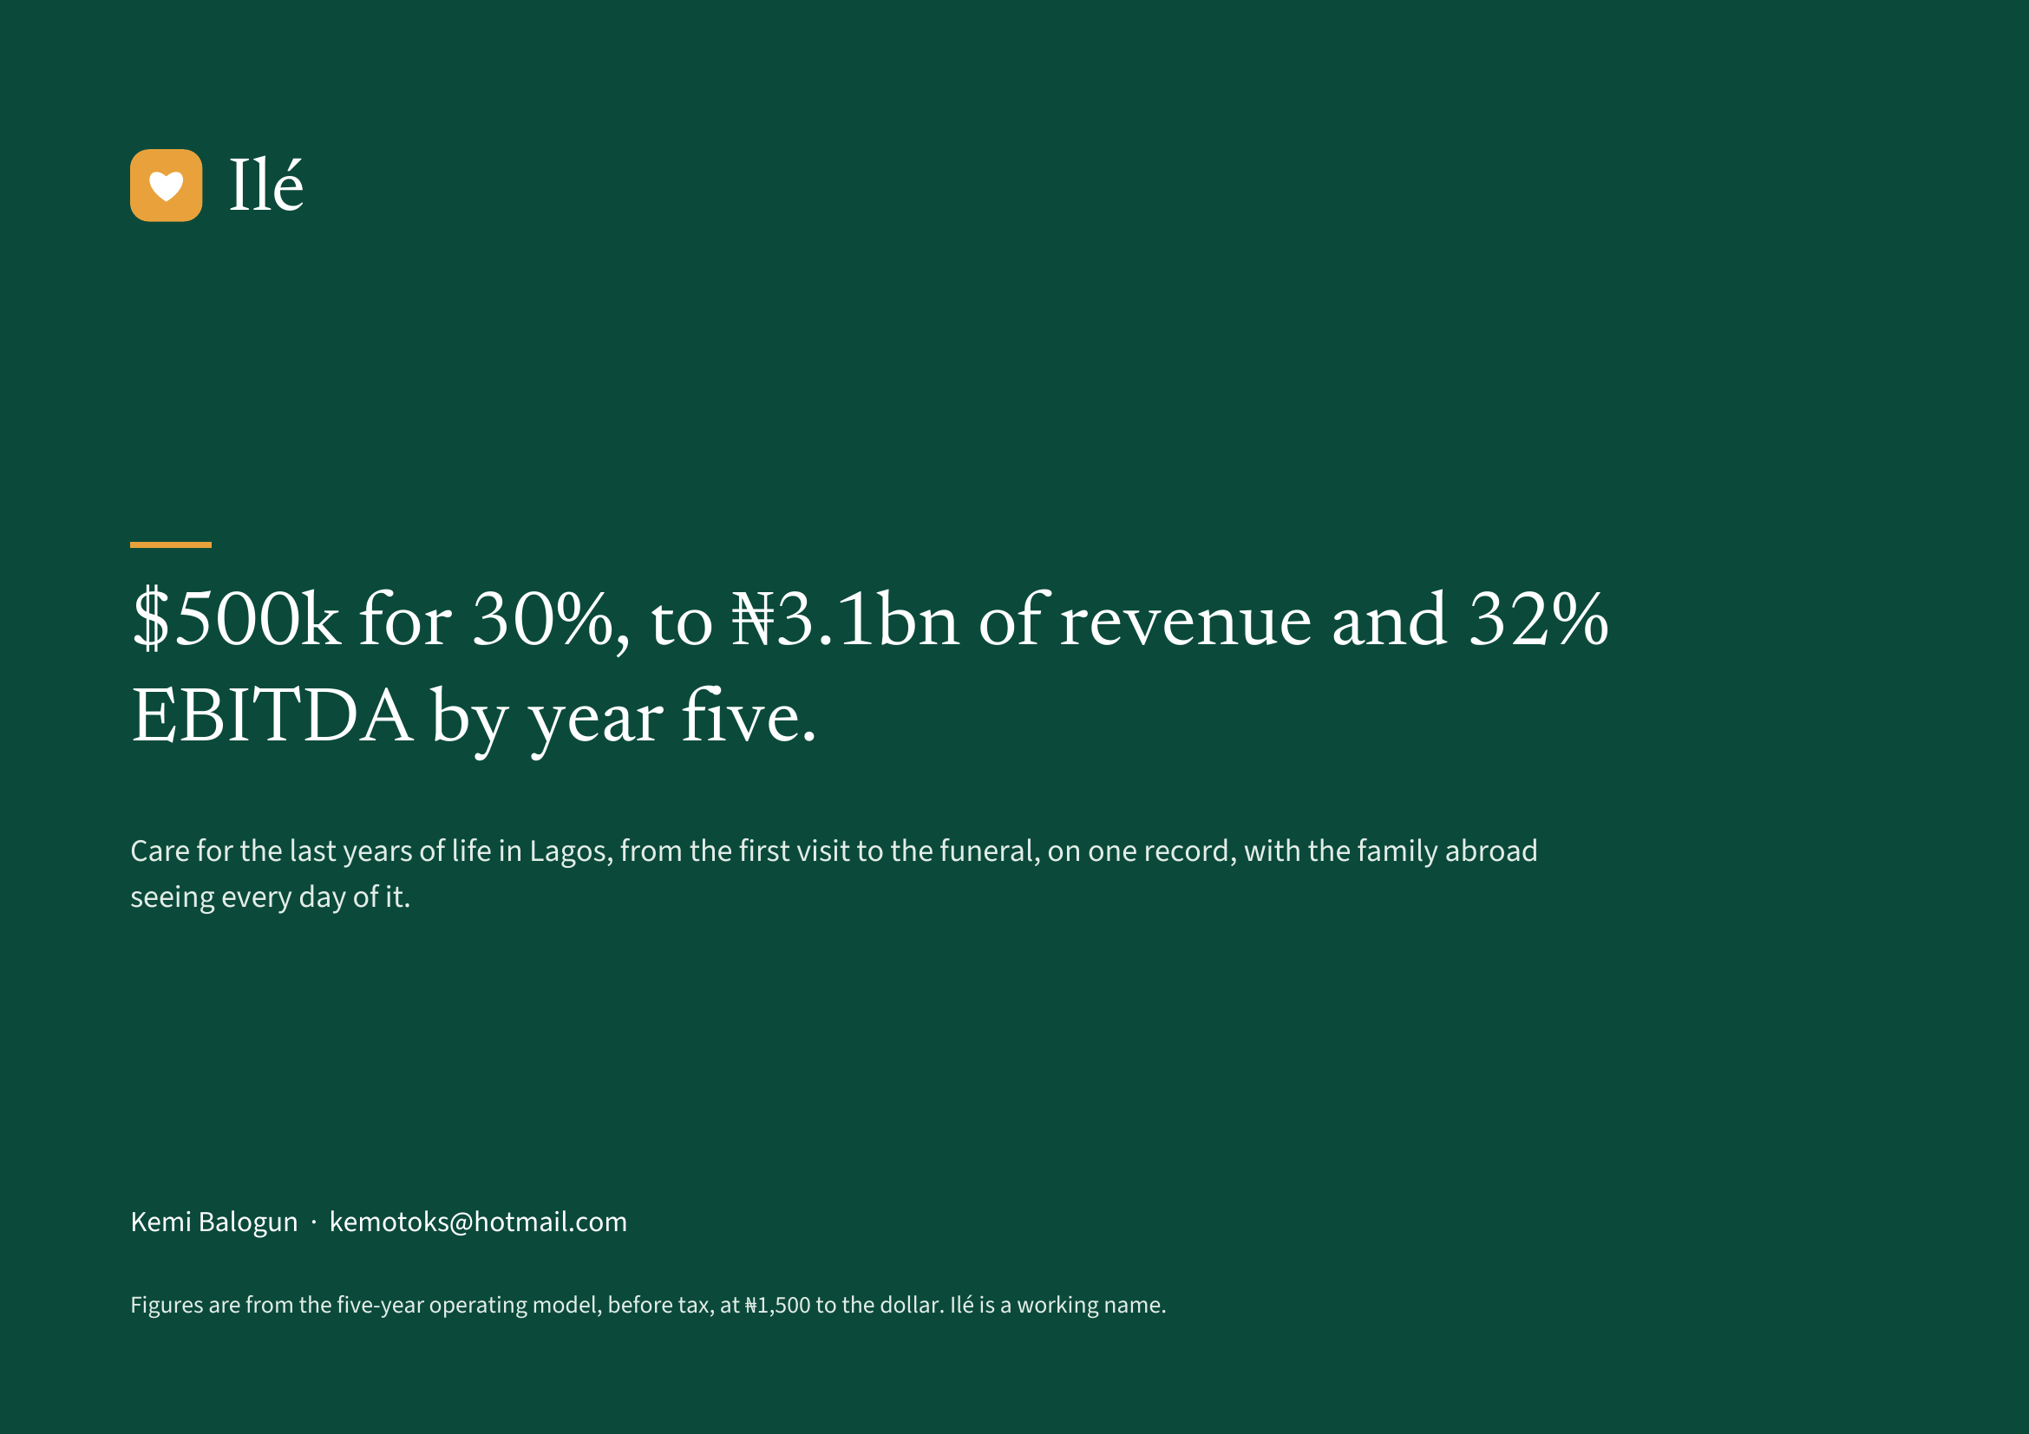
Notes:
Ilé
$500k for 30%, to ₦3.1bn of revenue and 32%
EBITDA by year five.
Care for the last years of life in Lagos, from the first visit to the funeral, on one record, with the family abroad
seeing every day of it.
Kemi Balogun · kemotoks@hotmail.com
Figures are from the five-year operating model, before tax, at ₦1,500 to the dollar. Ilé is a working name.

